Slide 1
Load VARIABLE DATA USING PROCESS CHAIN.
Milind Parab

Slide 2
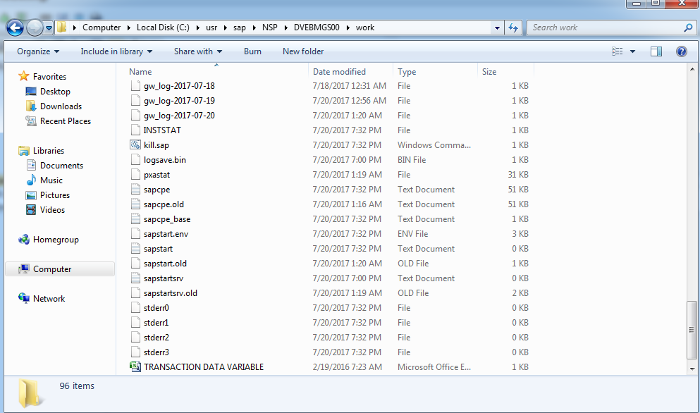
The Application Directory Path.

Slide 3
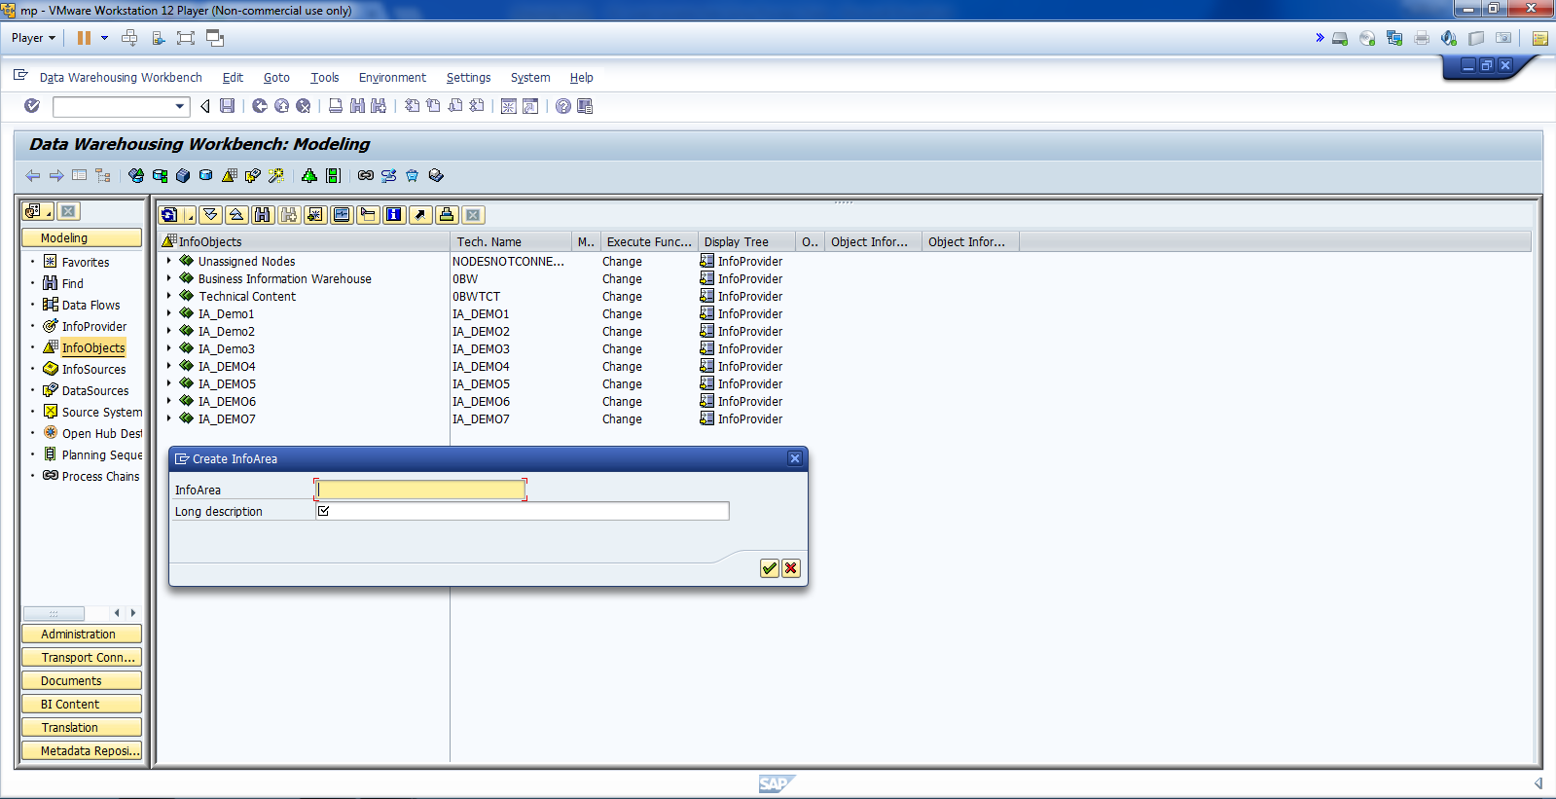
Create AC.

Slide 4
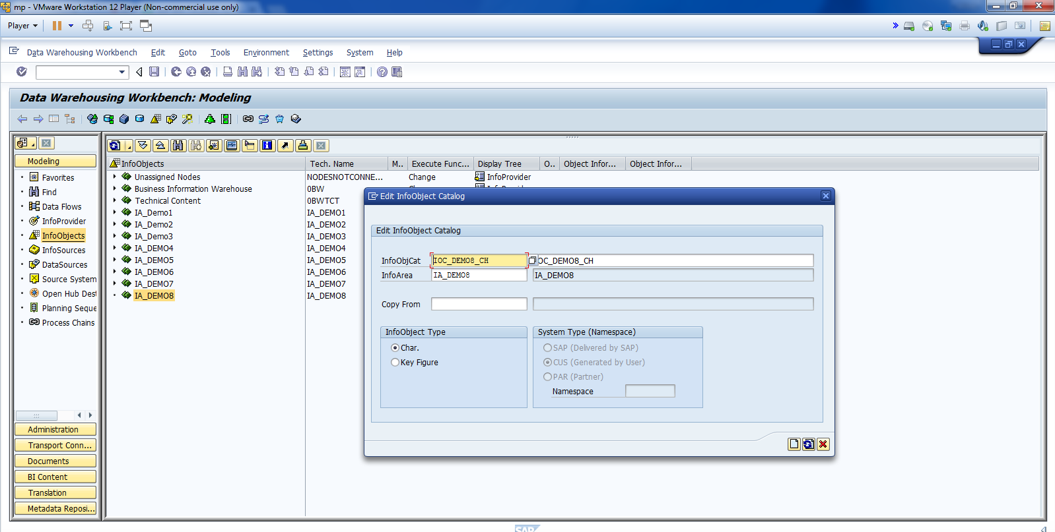
Create IOC for Char.

Slide 5
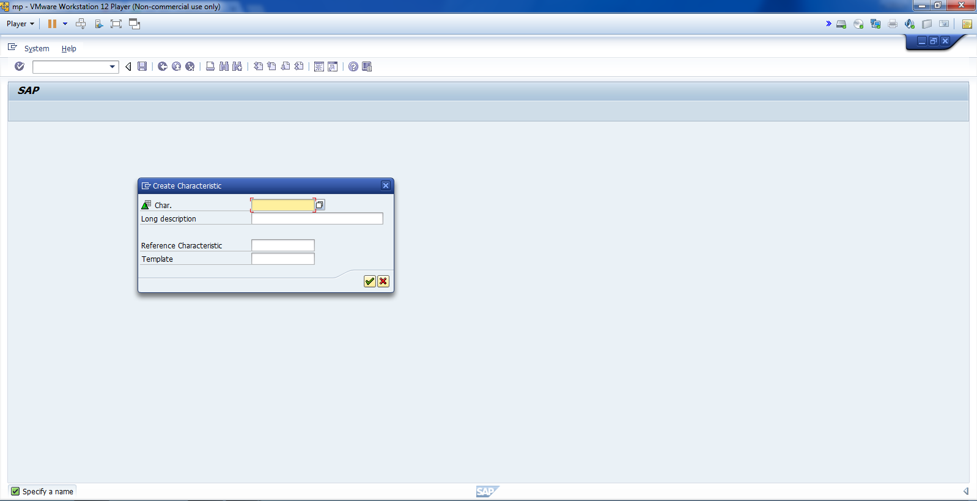
Create Two Info Objects.

Slide 6
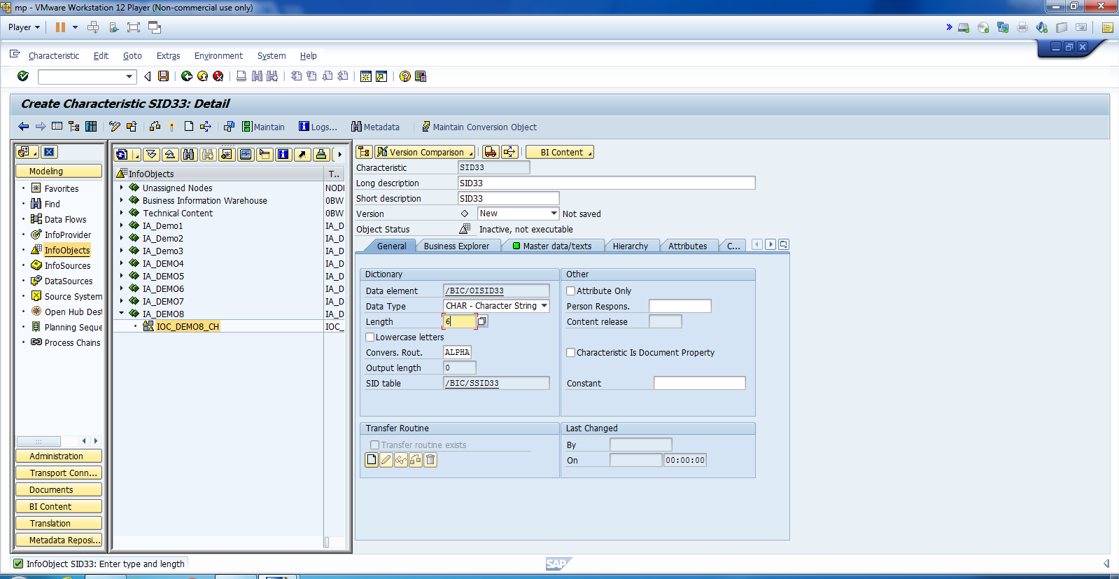
Update General Info.

Slide 7
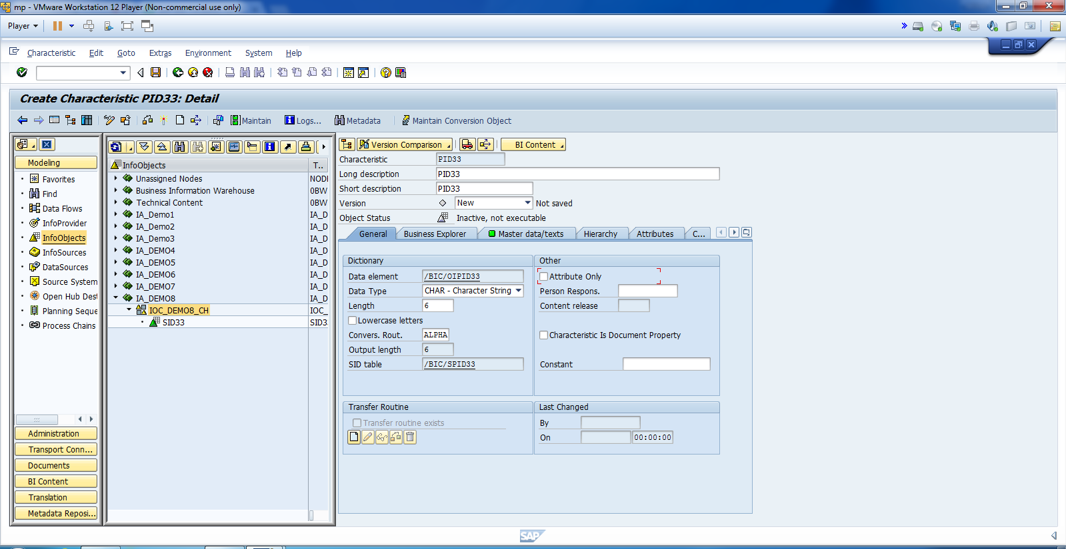
Similarly, Create PID.

Slide 8
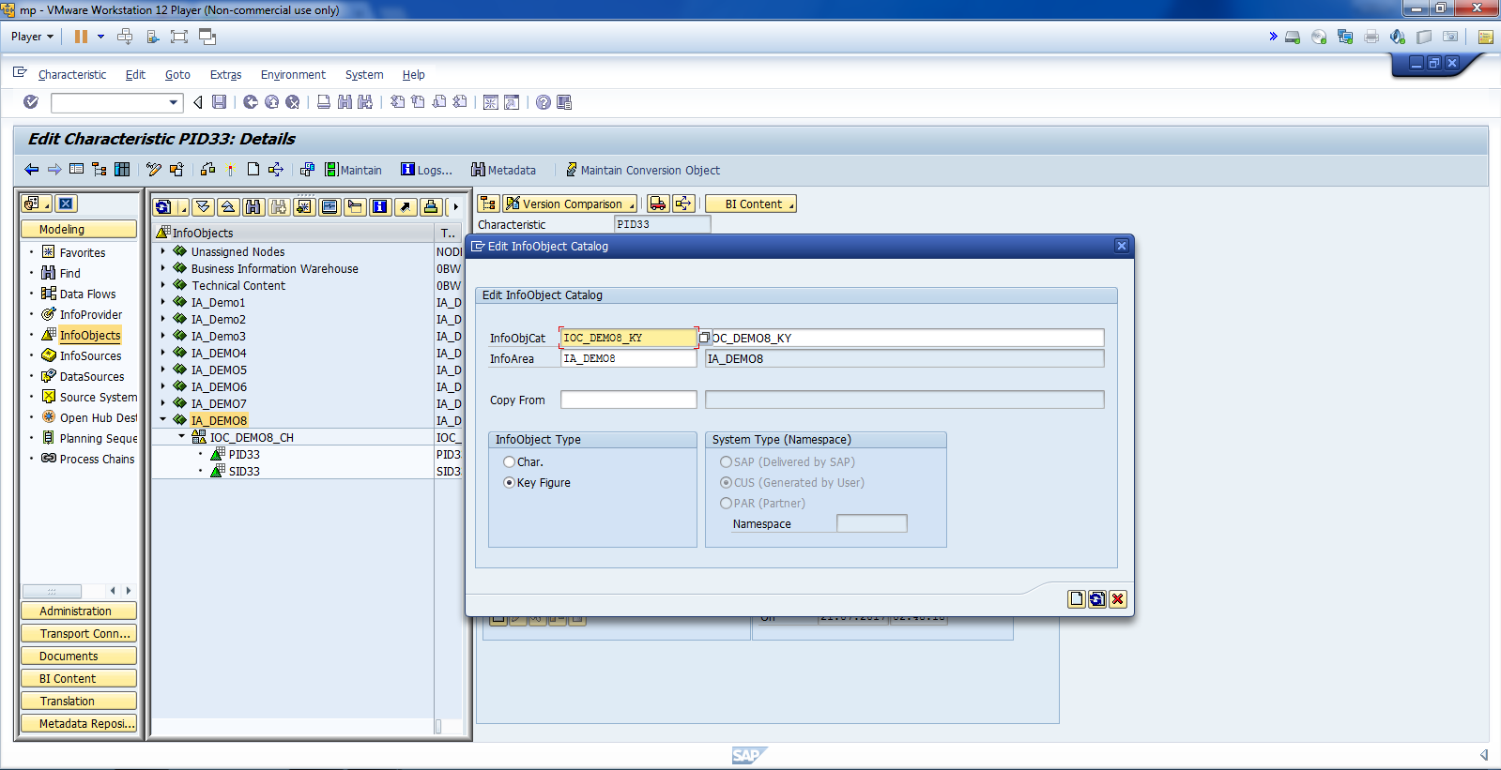
Create IOC for Key Fig.

Slide 9
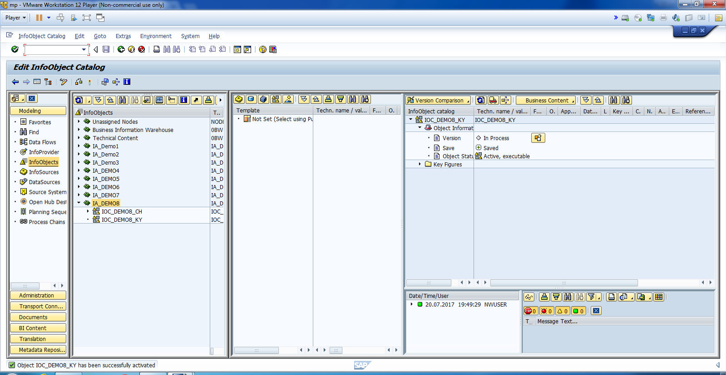
Activate IOC for KIO.

Slide 10
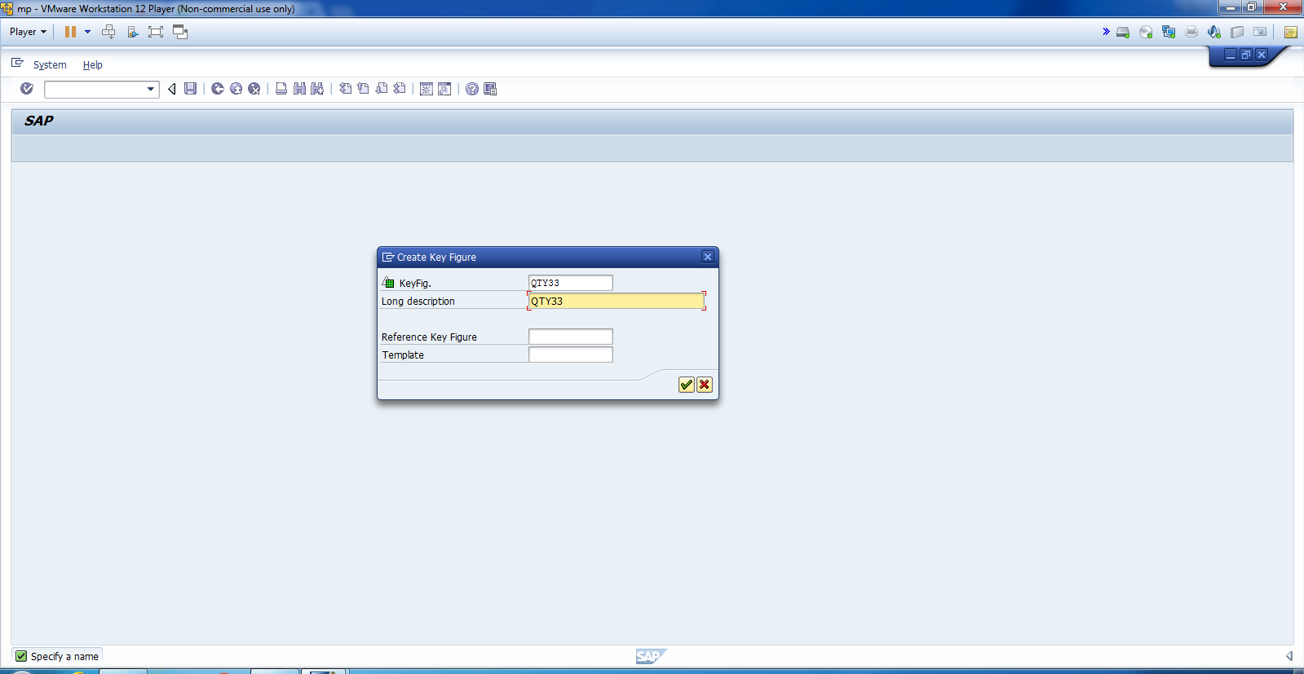
Create KIO: Quantity.

Slide 11
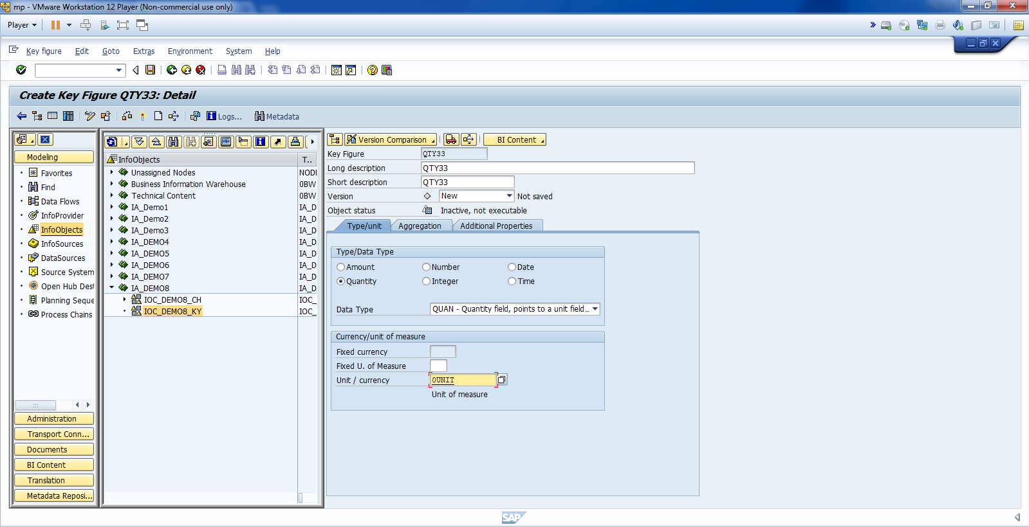
Cont.

Slide 12

Create KOI: Sales Revenue.

Slide 13
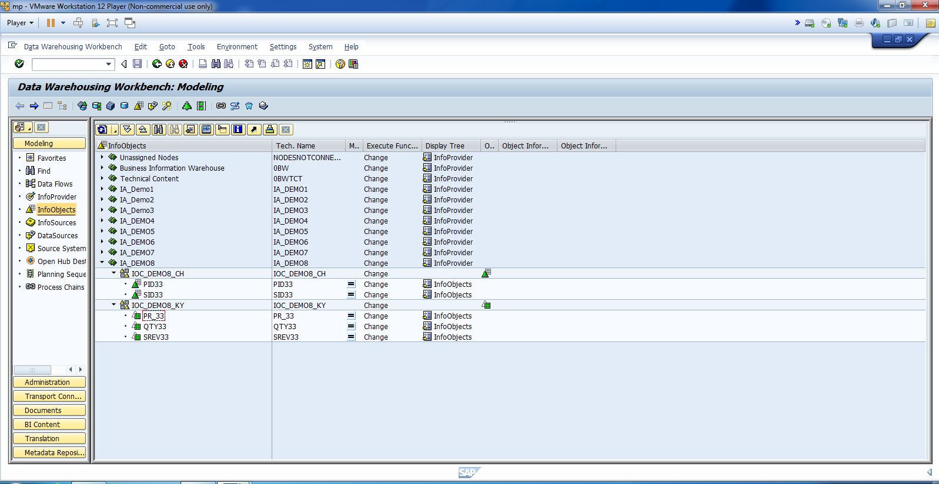
The Final Structure, 2 Ch. IO. And 3 Key. IO.

Slide 14
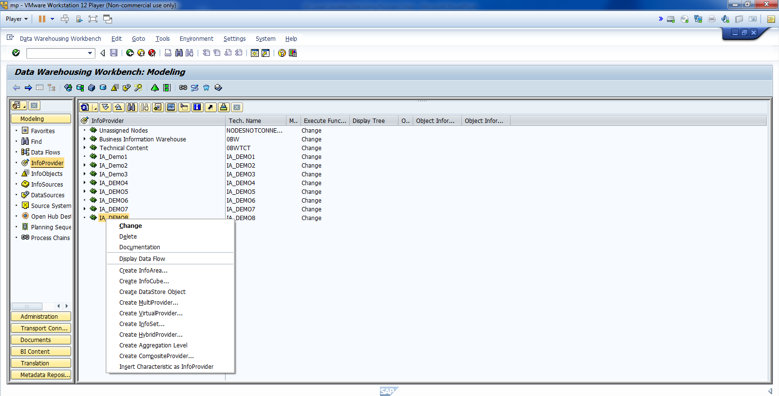
Create Info Cube as DT.

Slide 15
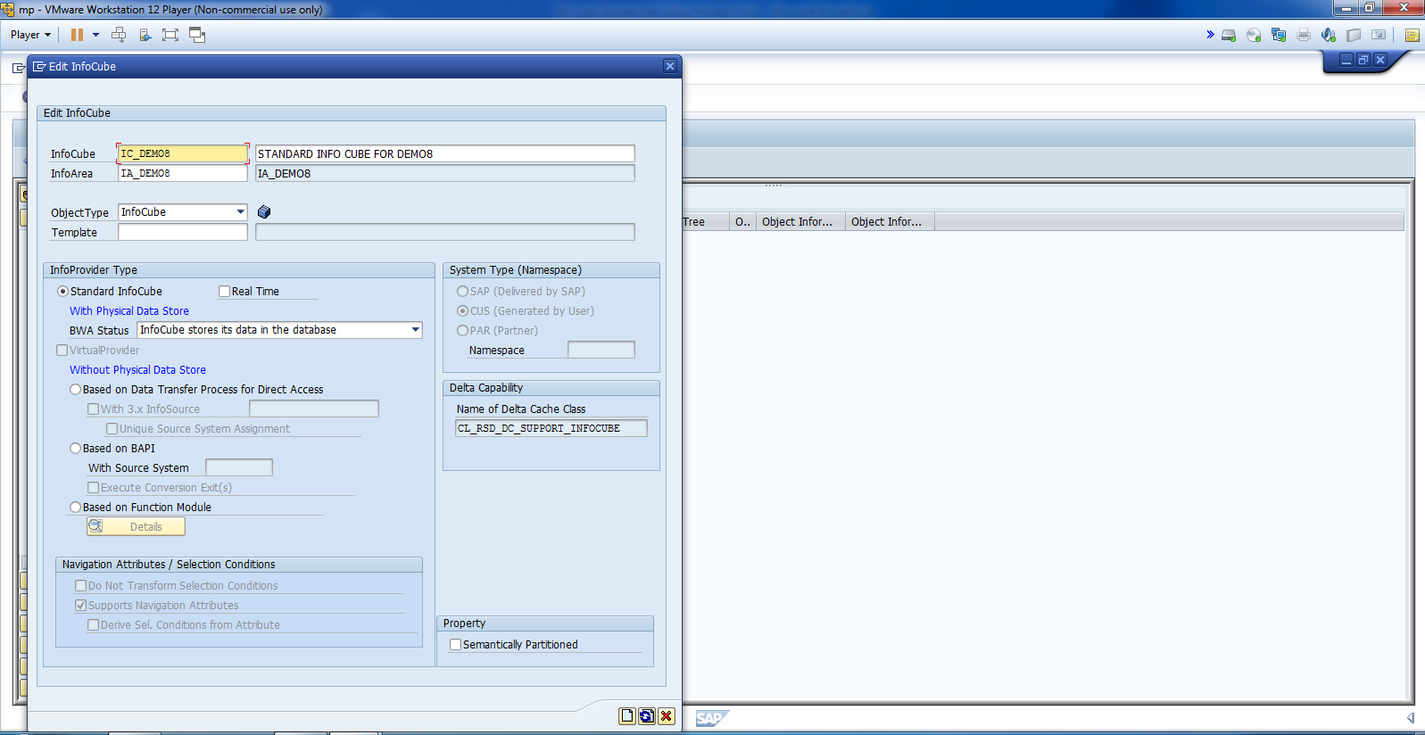
Create Info Cube.

Slide 16
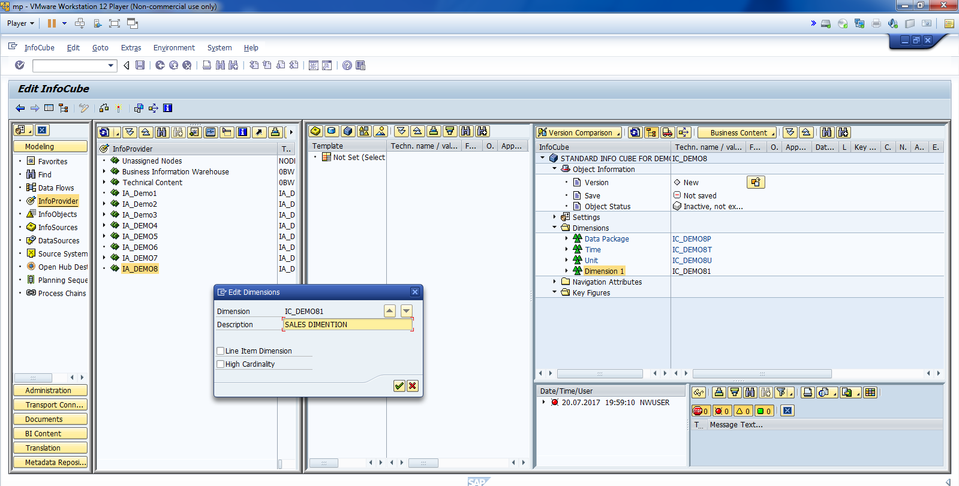
Rename Dimention1.

Slide 17
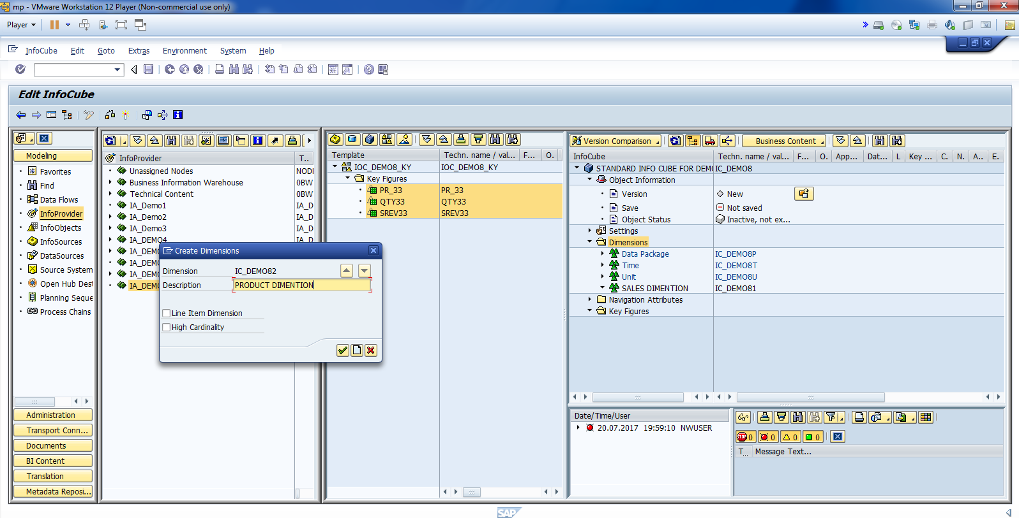
Create A New Dim for Product.

Slide 18
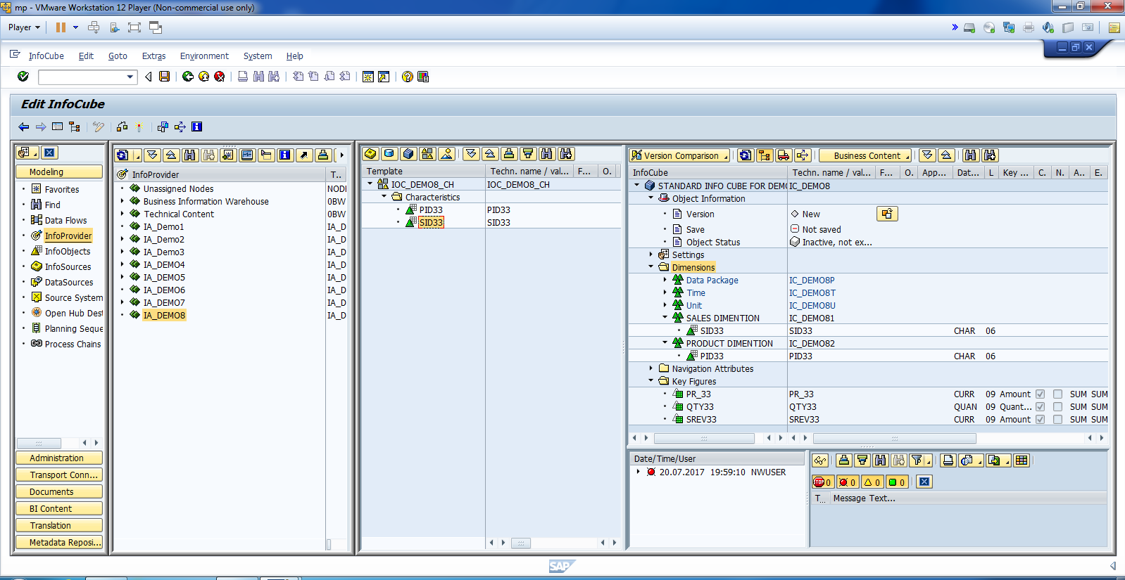
Drag and Drop Key and Ch Attribute.

Slide 19
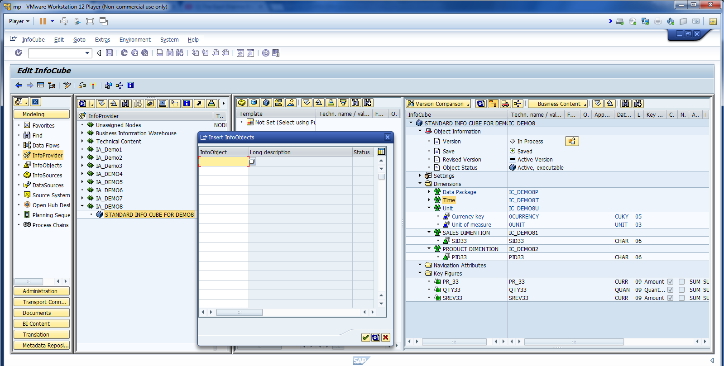
Add time attribute.

Slide 20
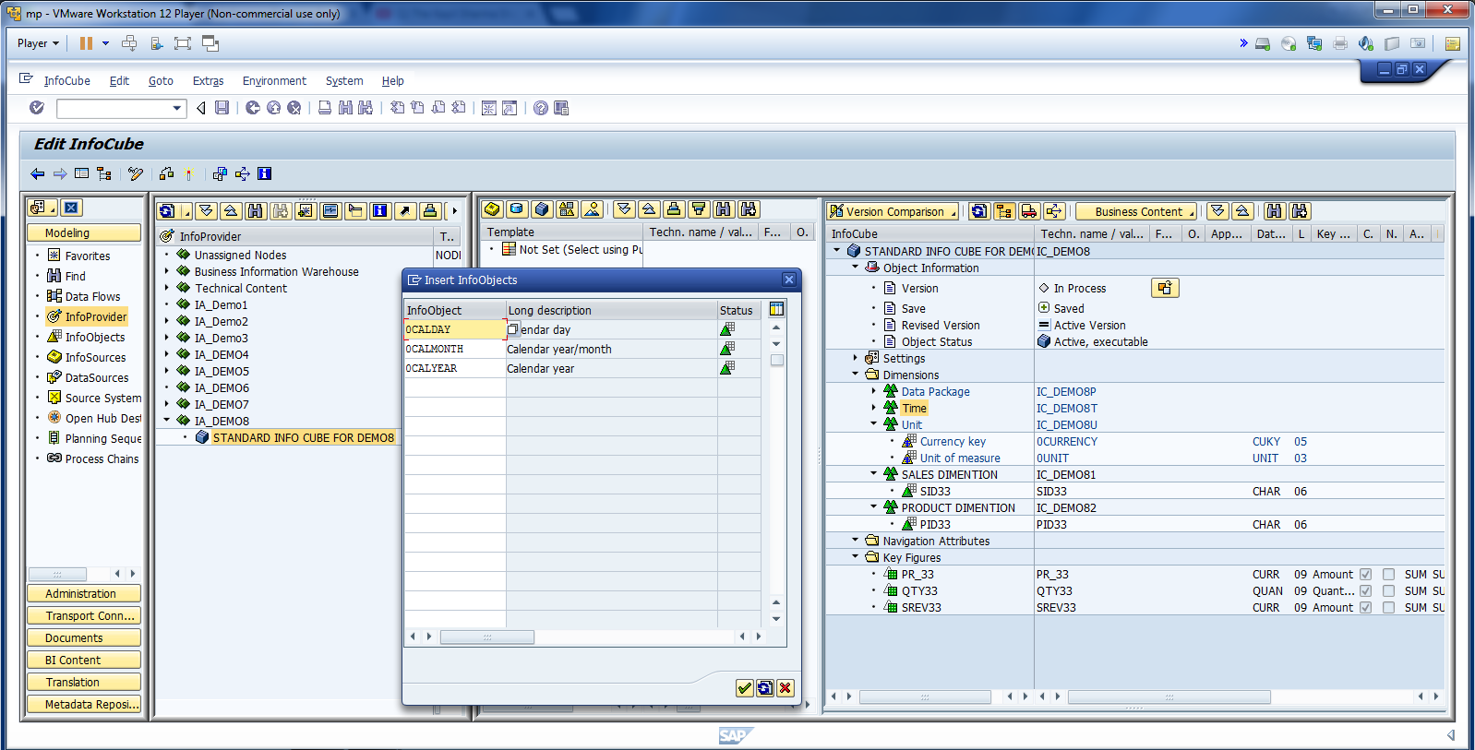
Cont.

Slide 21
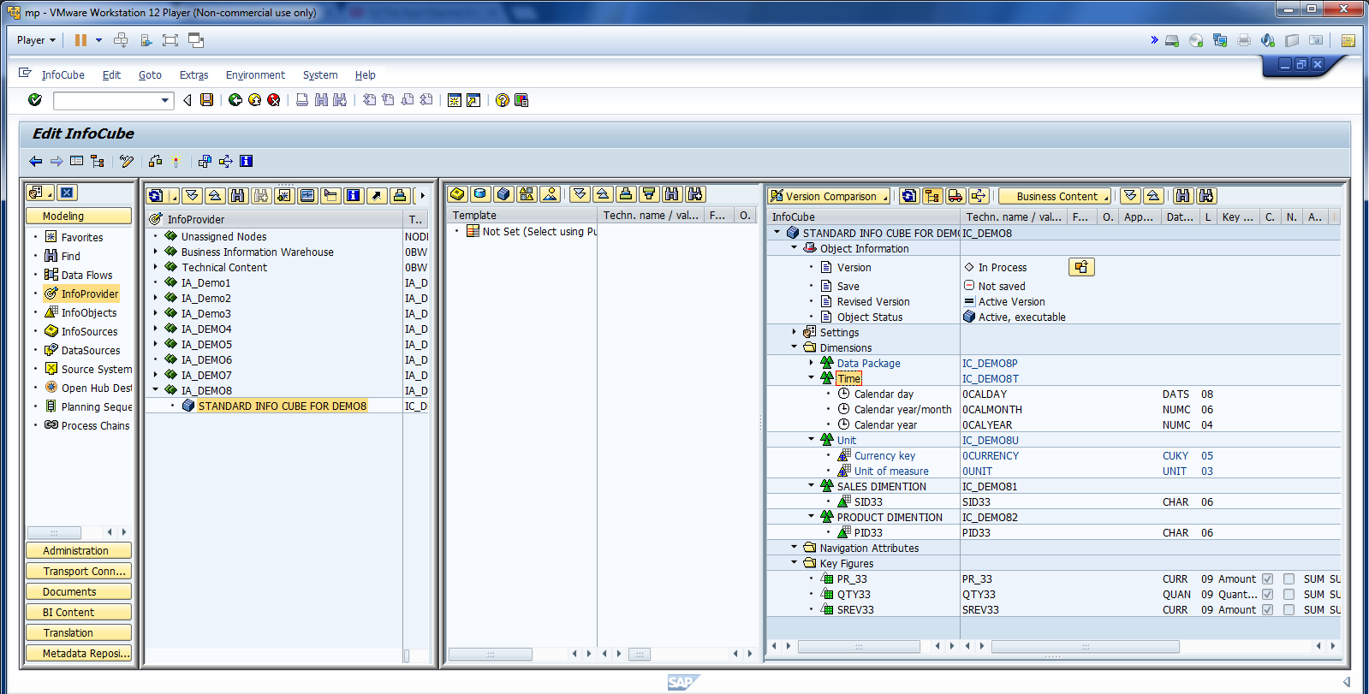
Activate Info Cube.

Slide 22
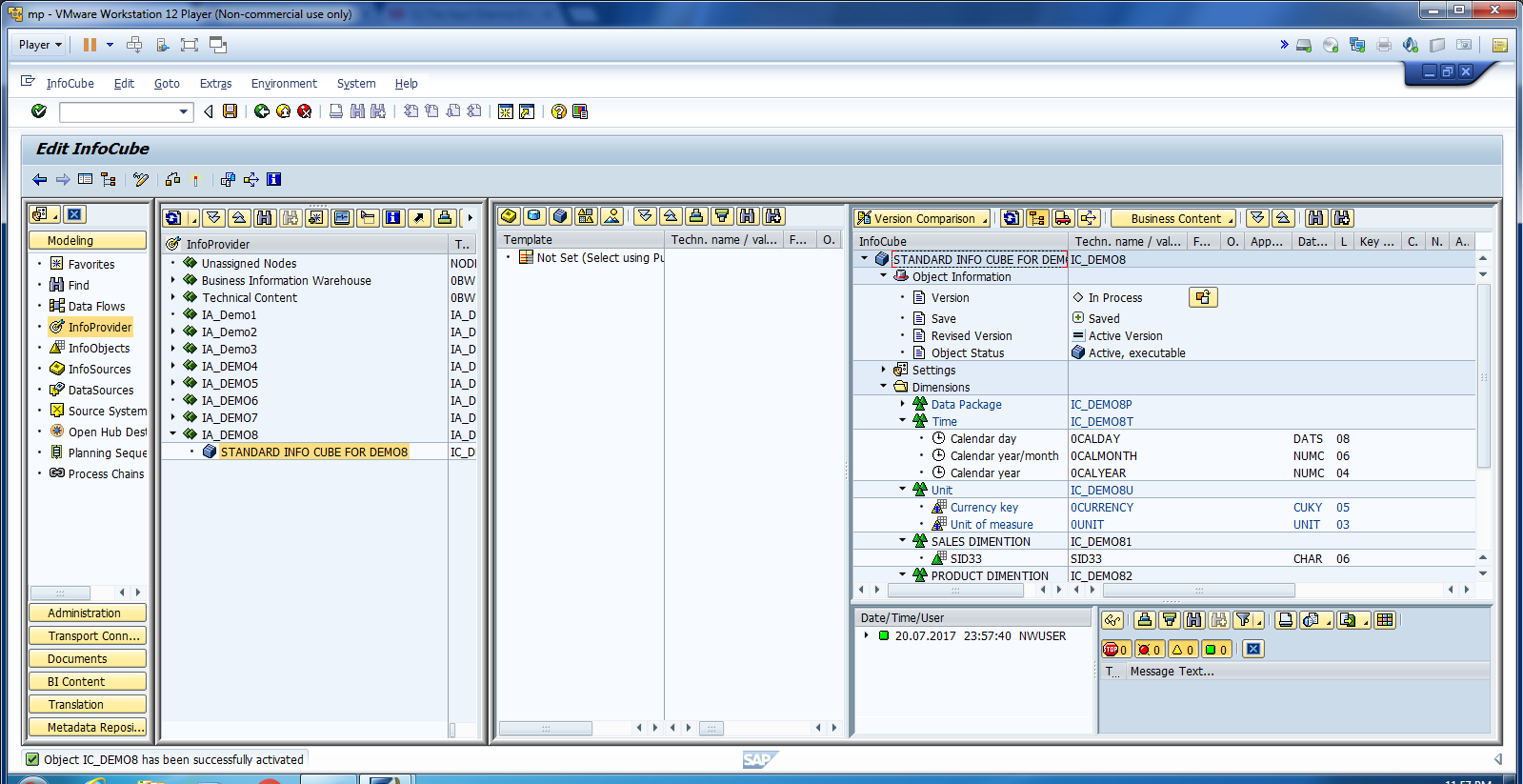
Cont.

Slide 23
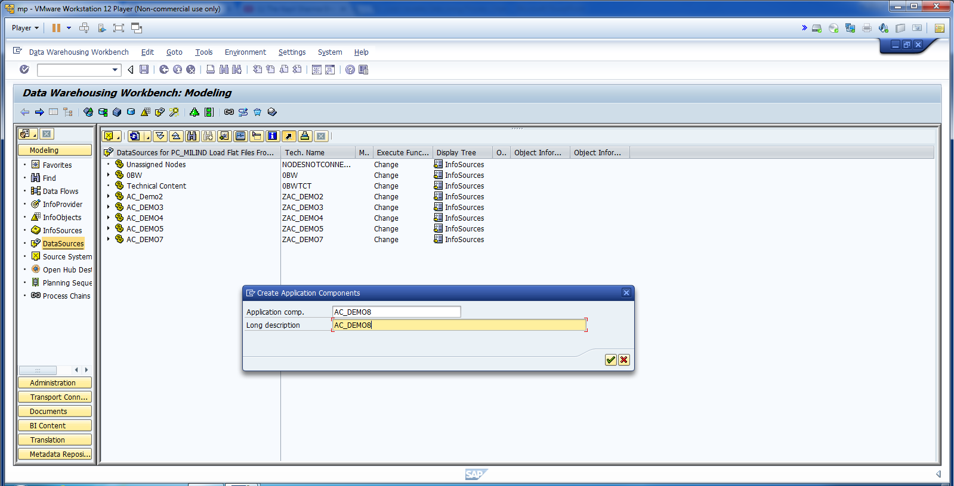
Now, create a Data Source.

Slide 24
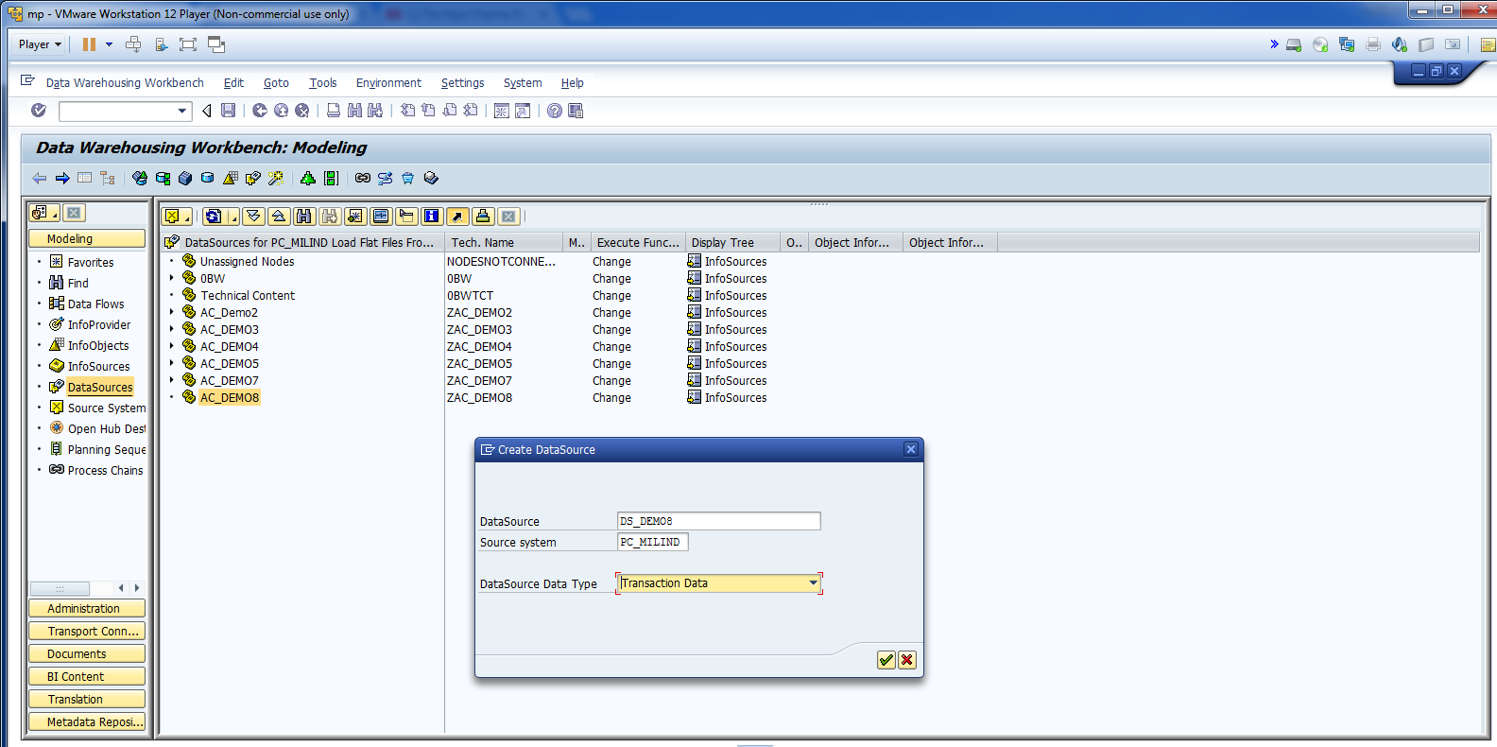
Cont.

Slide 25
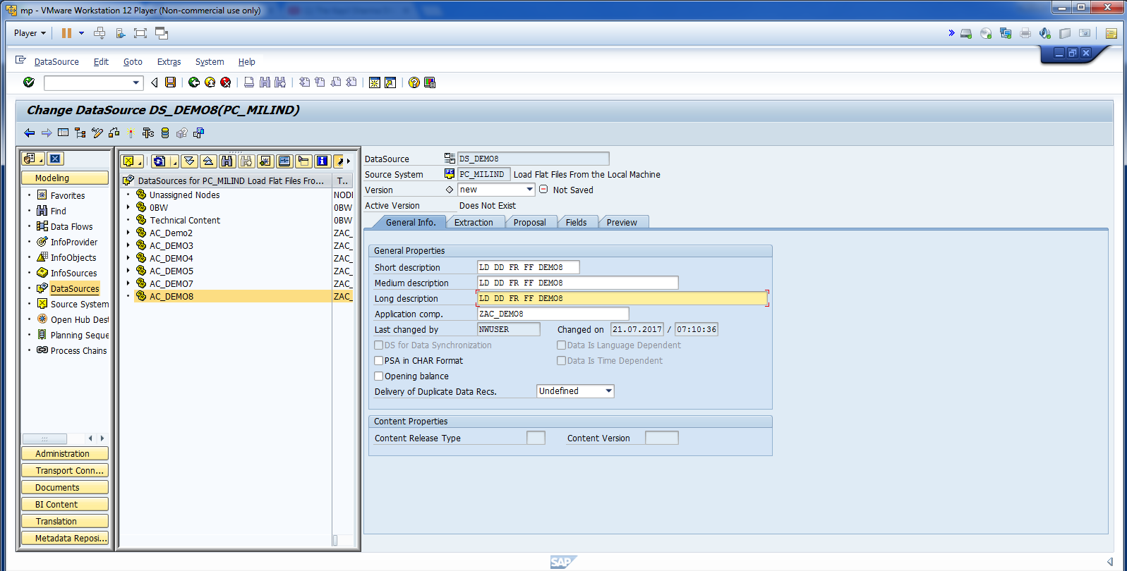
Cont.

Slide 26
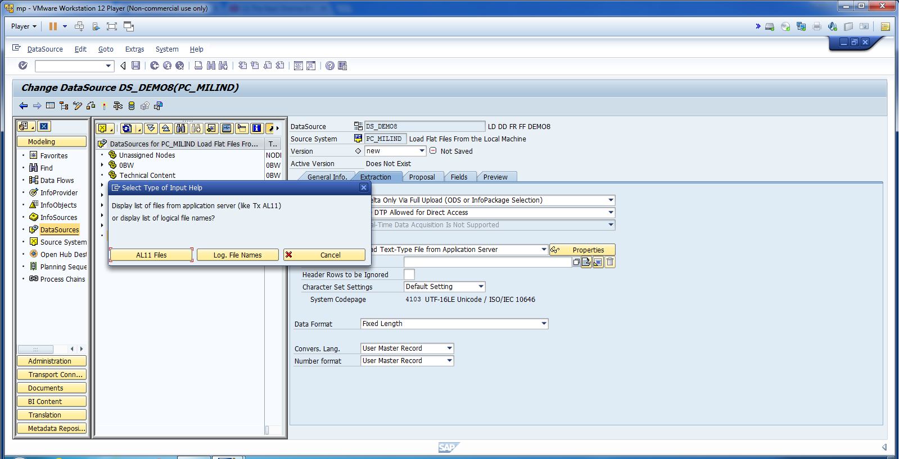
Select Load from Application Server.

Slide 27
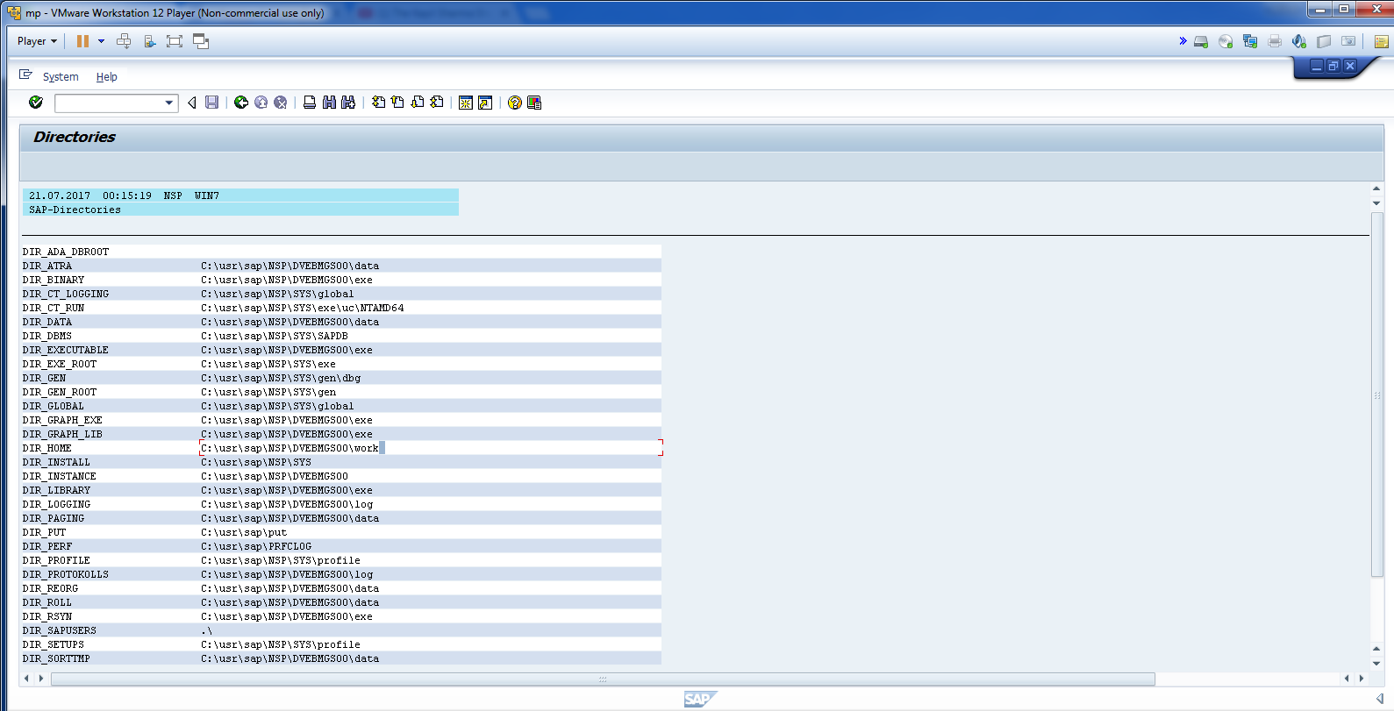
Cont. Select Home Direct.

Slide 28
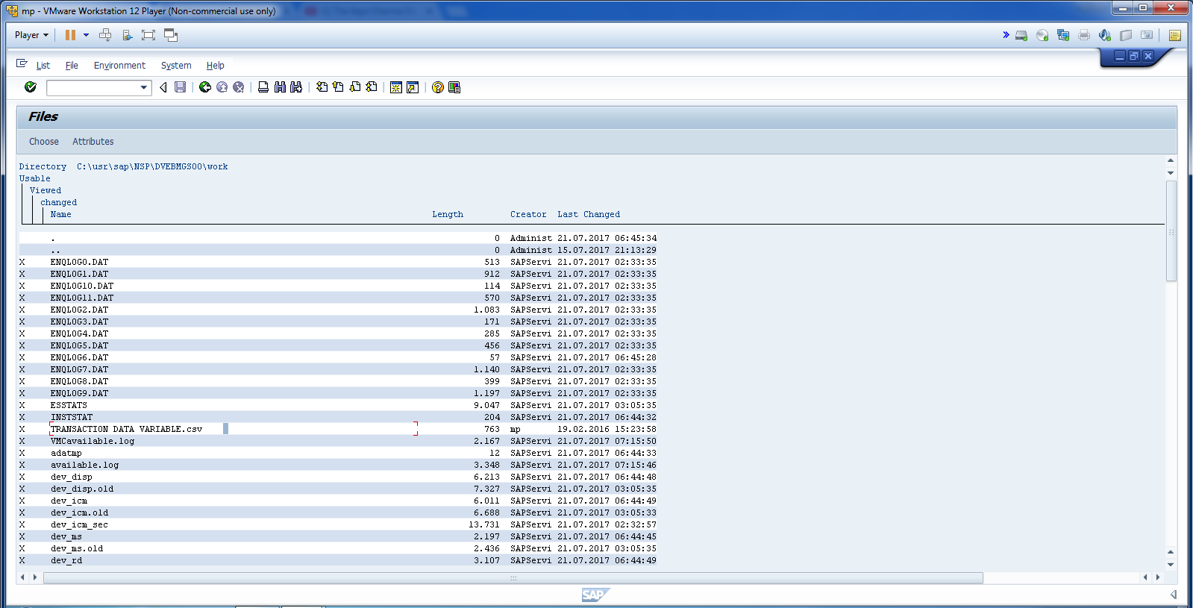
Cont.

Slide 29
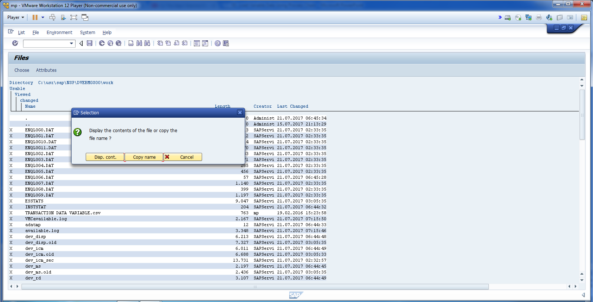
Select Copy Name.

Slide 30
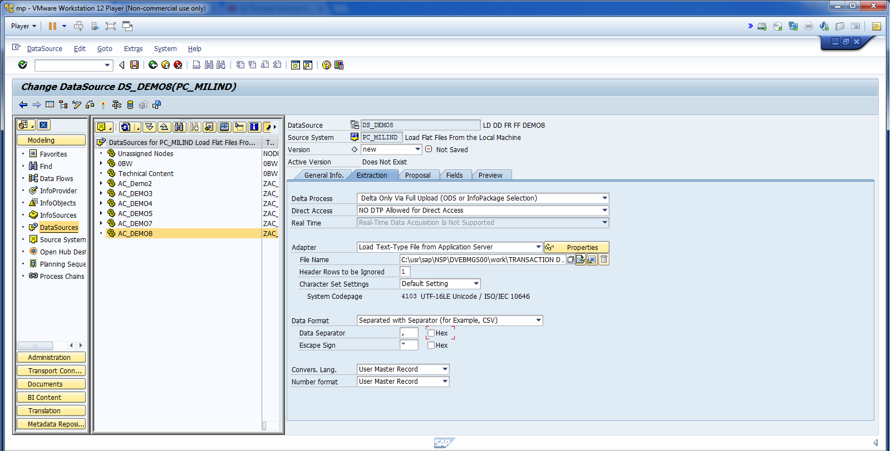
Cont.

Slide 31
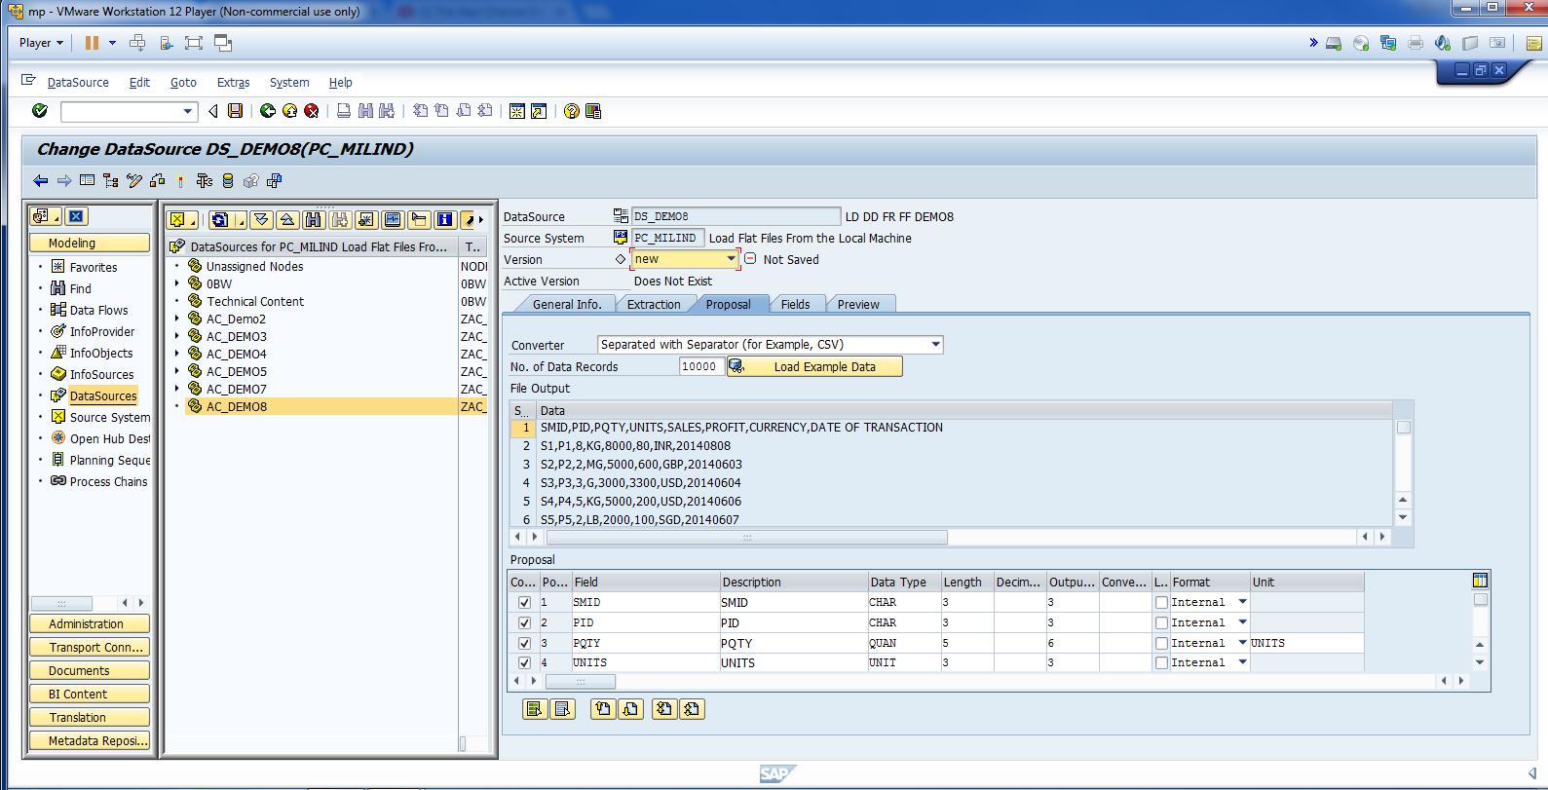
Cont.

Slide 32
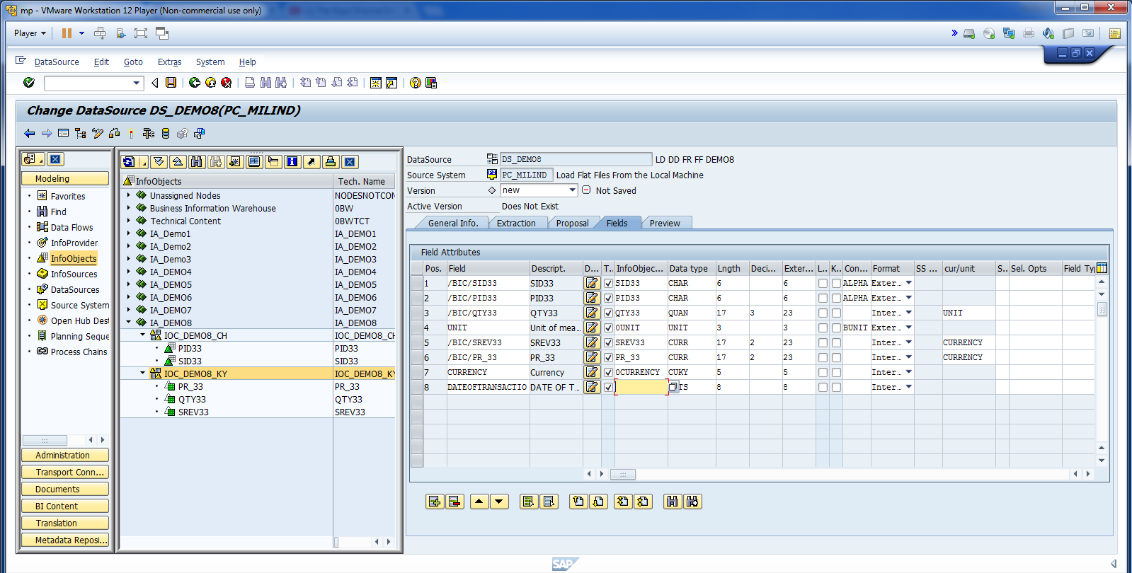
Map all Fields.

Slide 33
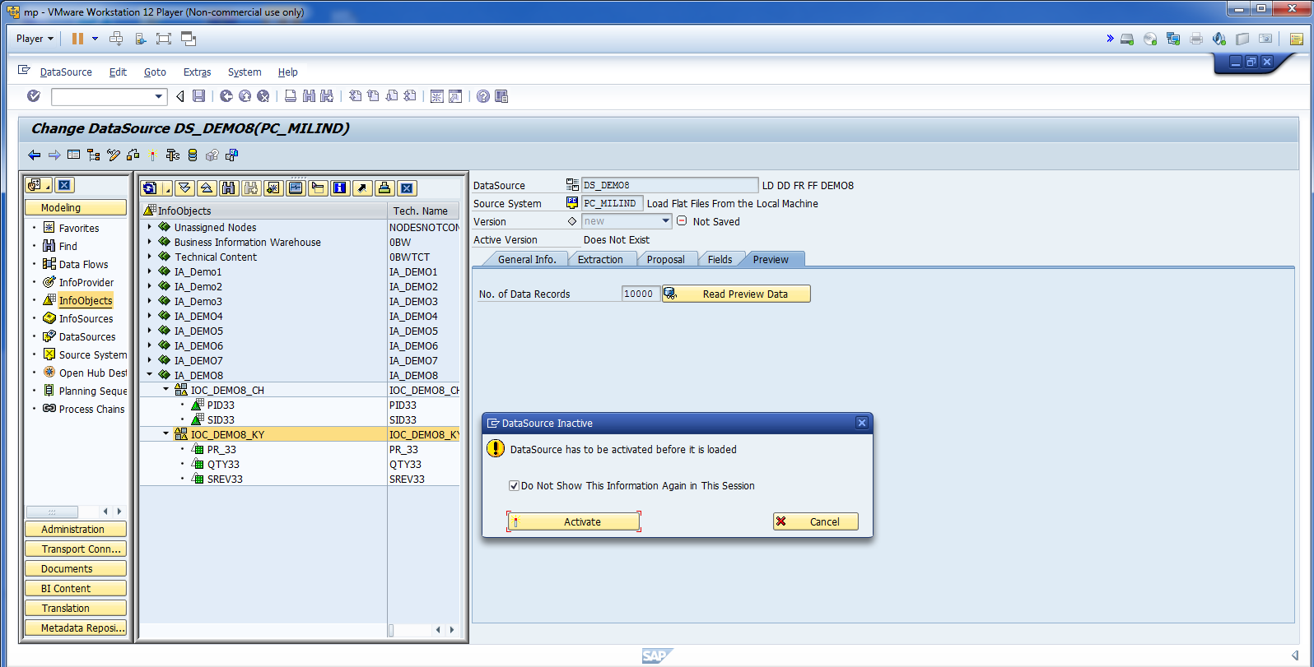
Activate Data Source.

Slide 34
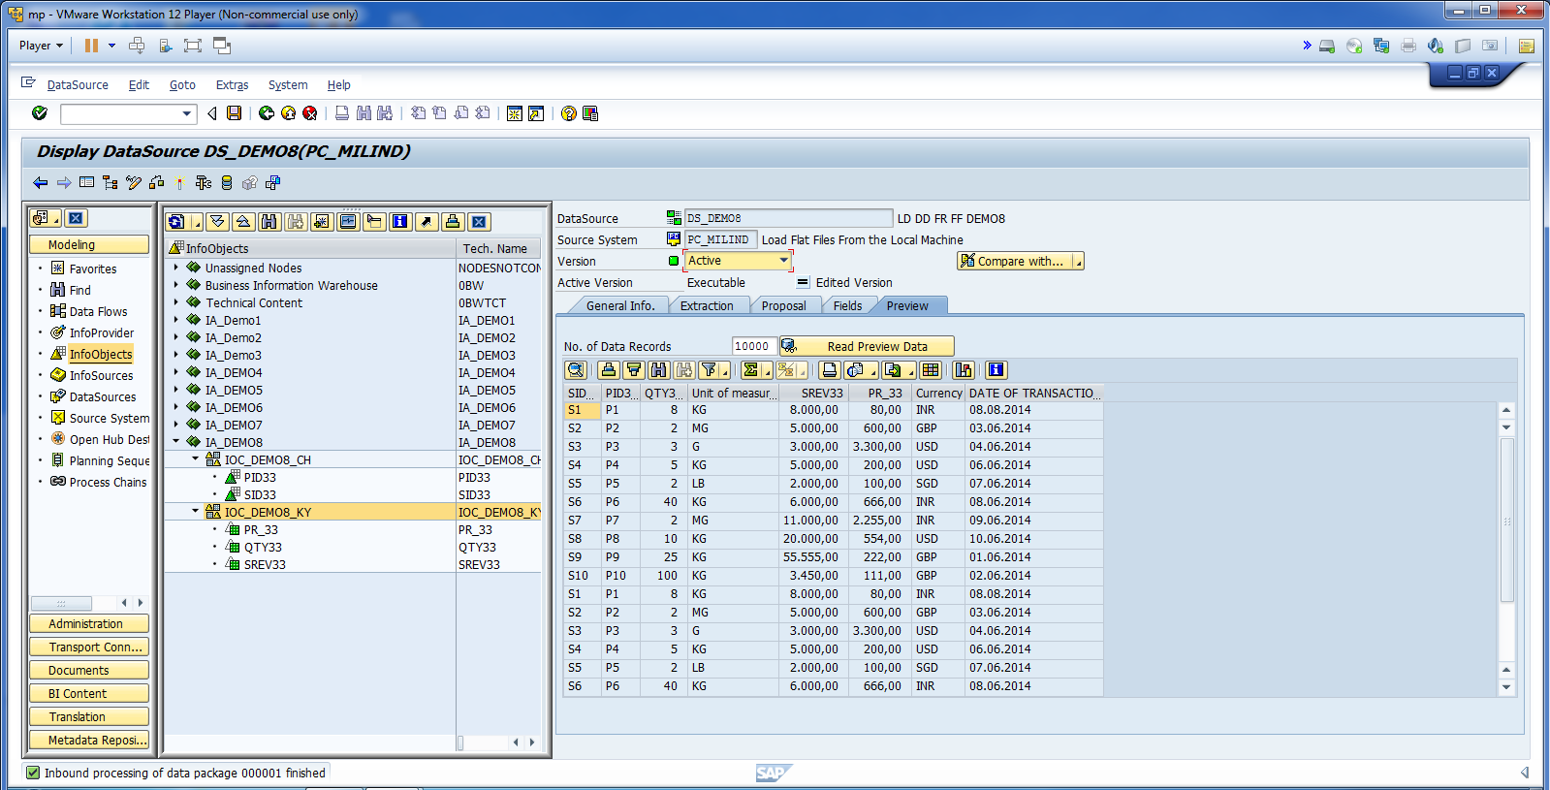
Check Data Preview.

Slide 35
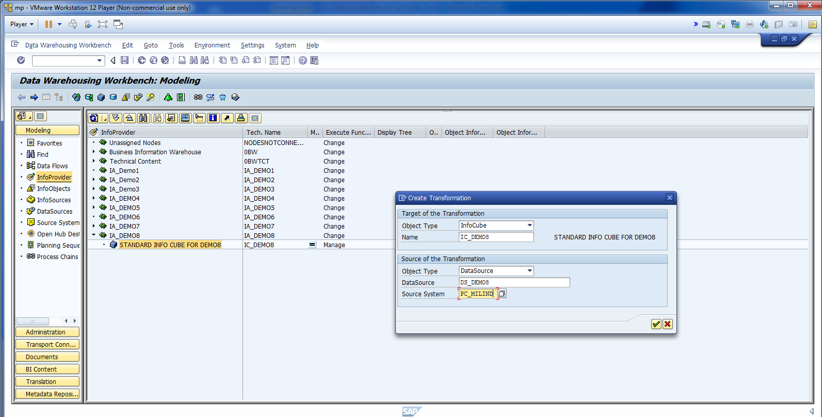
Create Transformation.

Slide 36
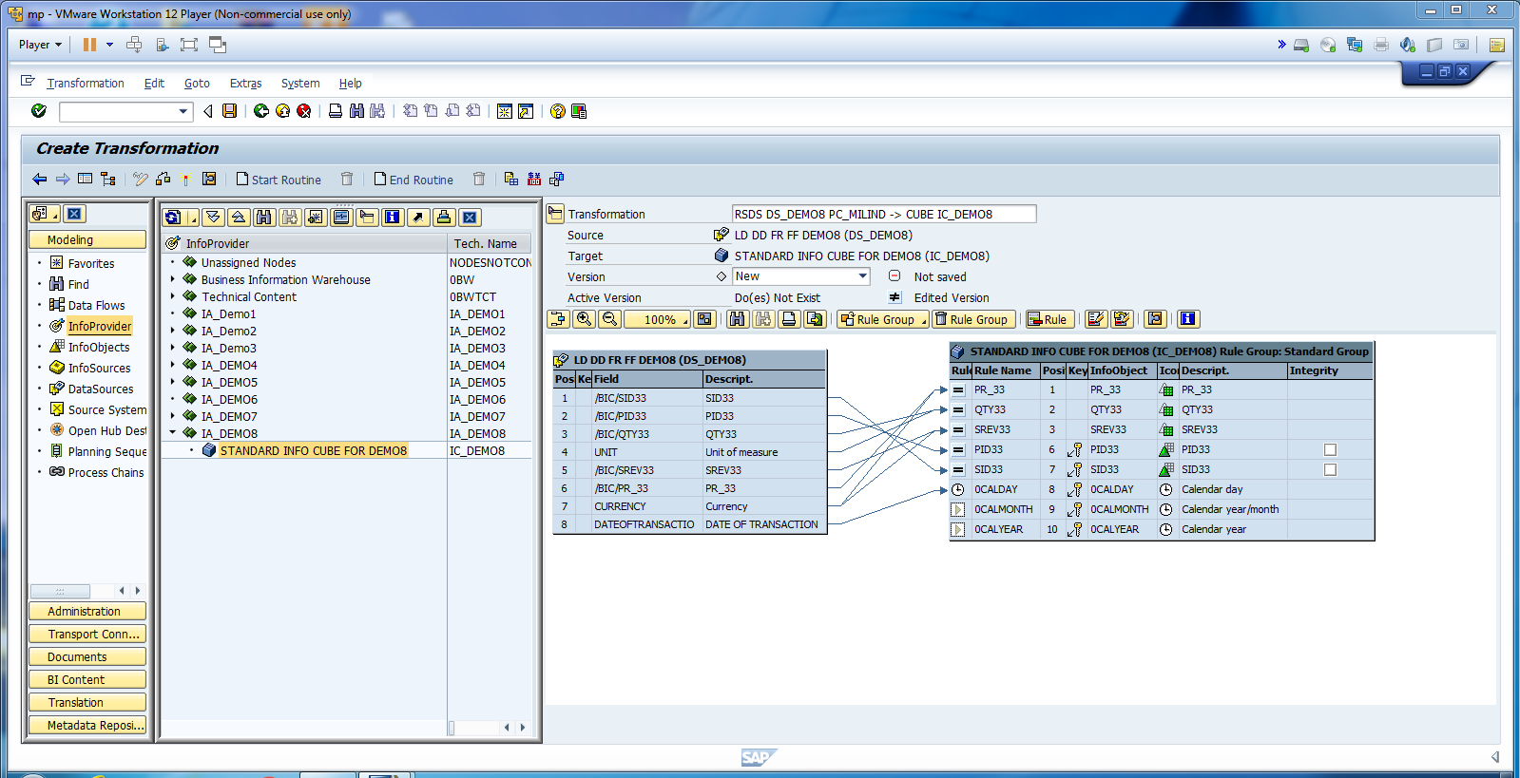
Cont.

Slide 37
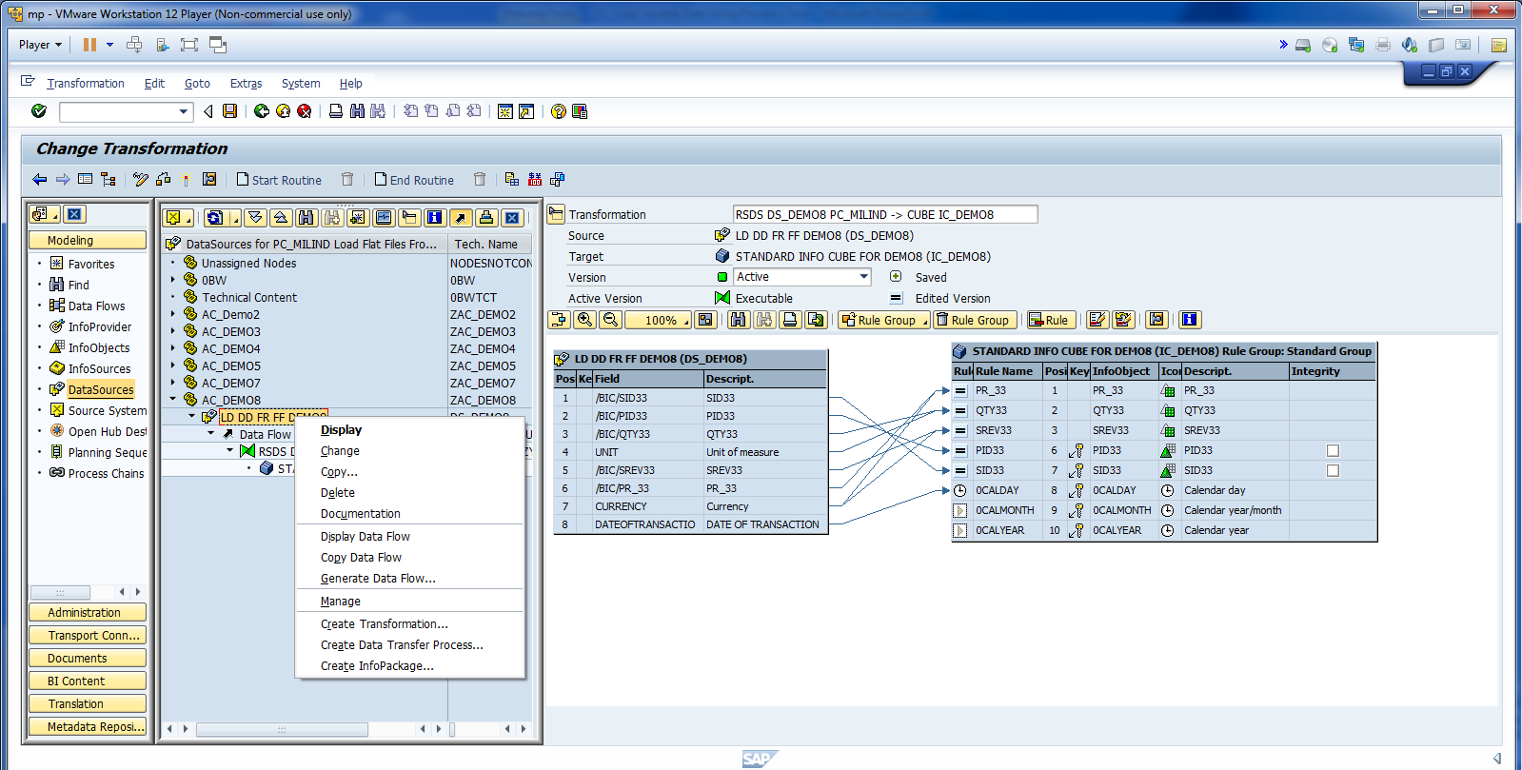
Create Info Package.

Slide 38
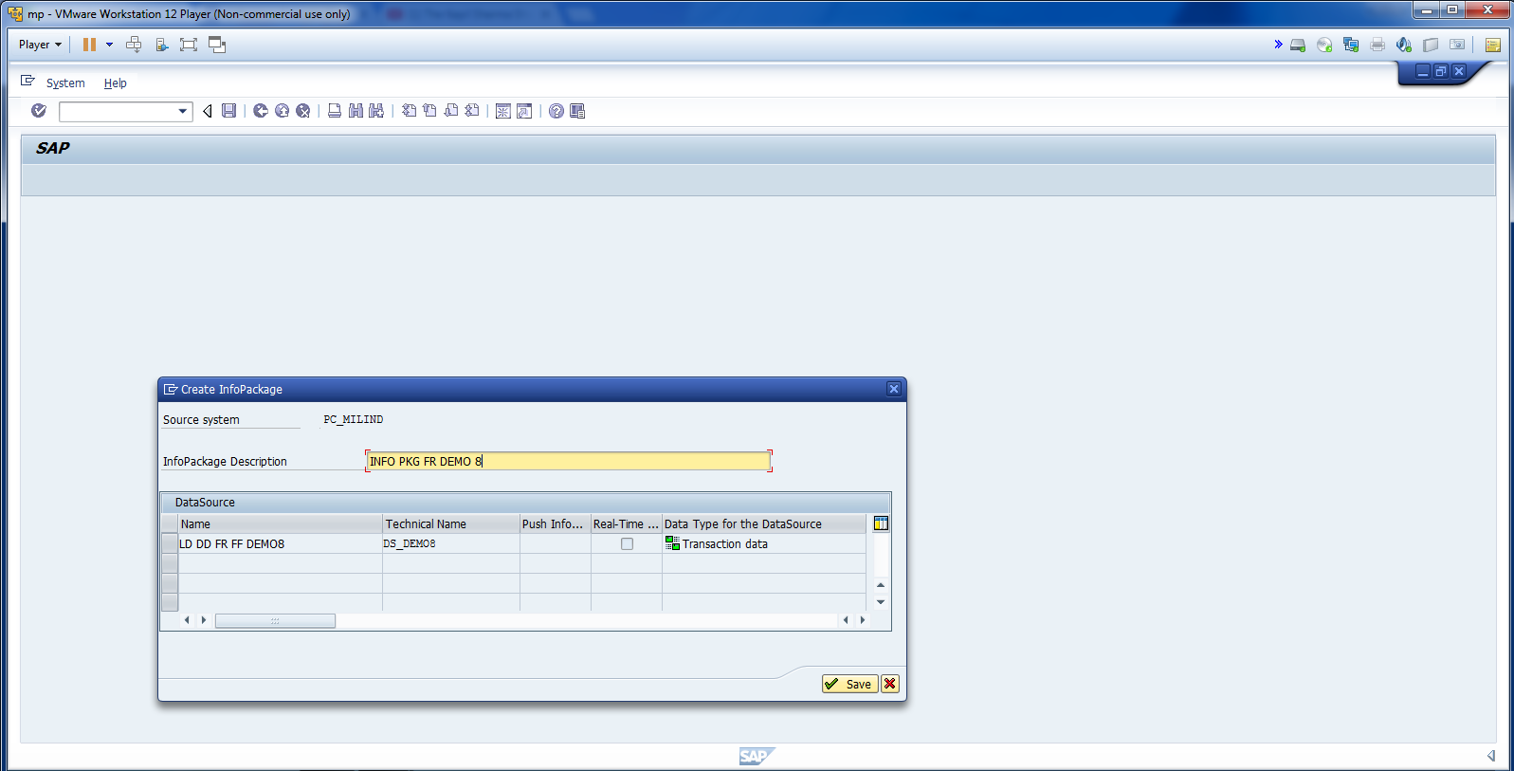
Cont.

Slide 39
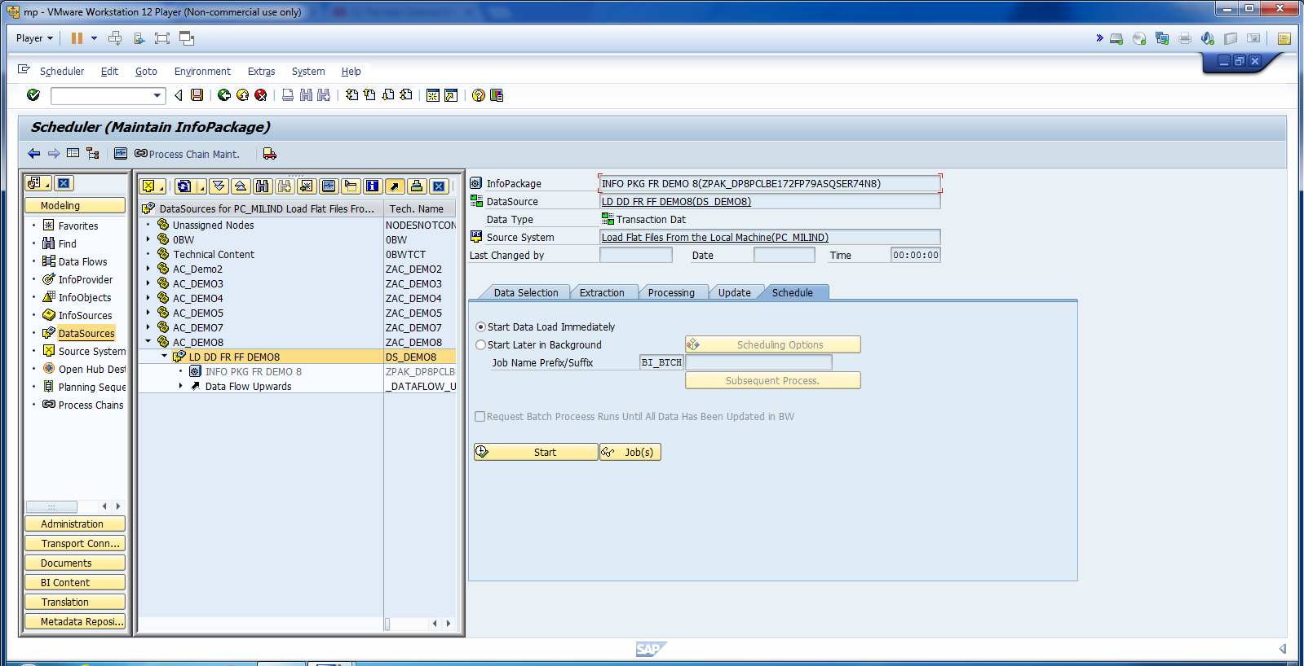
DON’T CLICK ON START. We want to load the data through process chain.

Slide 40
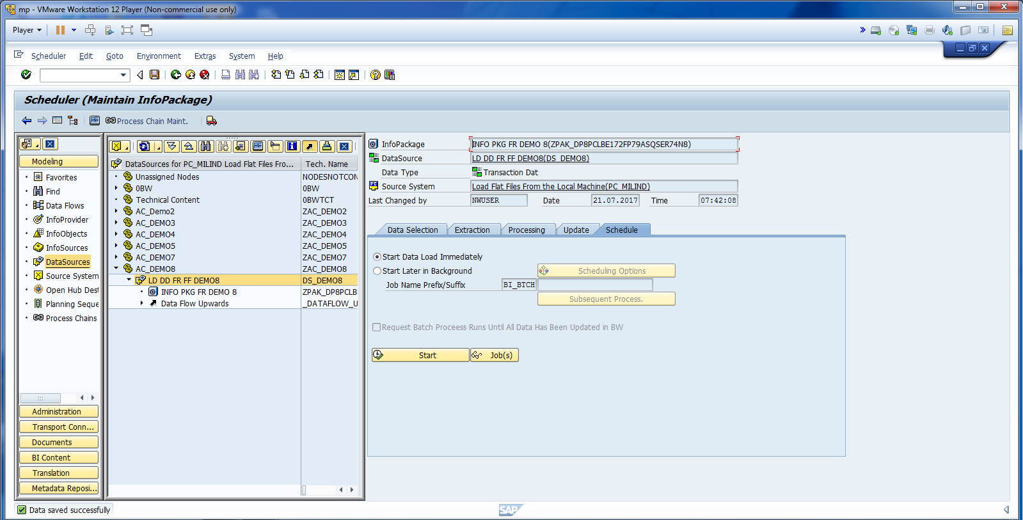
Click on SAVE.

Slide 41
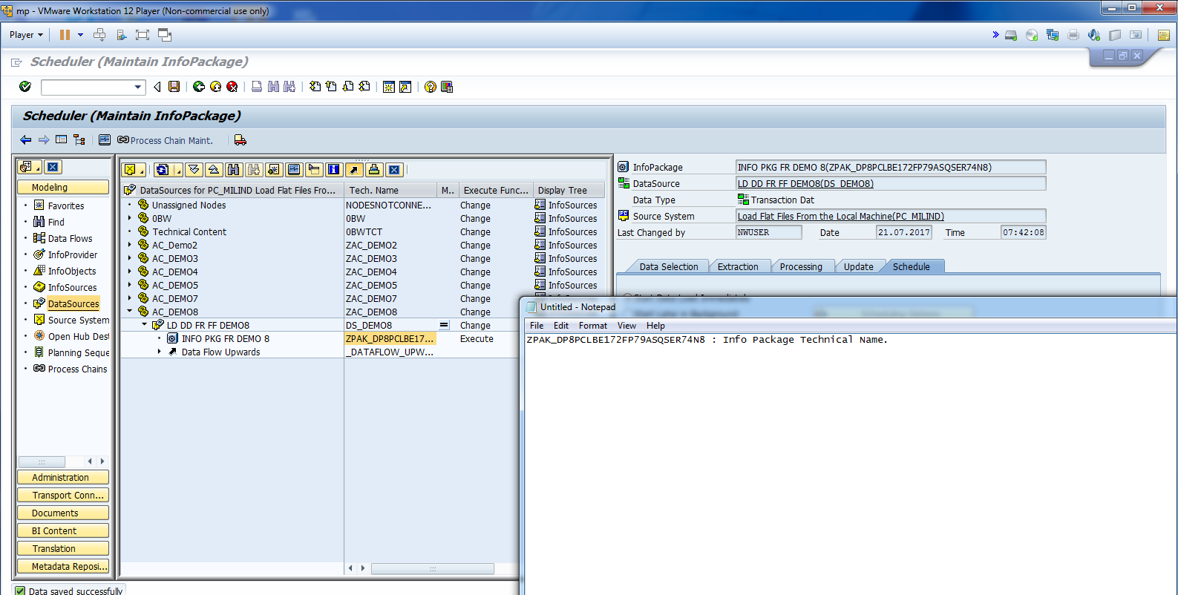
Copy Info Package Tech Name.

Slide 42
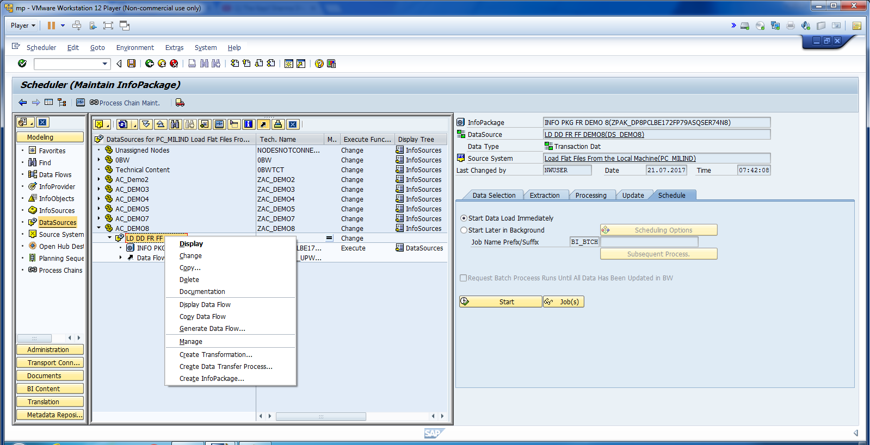
Create DTP.

Slide 43
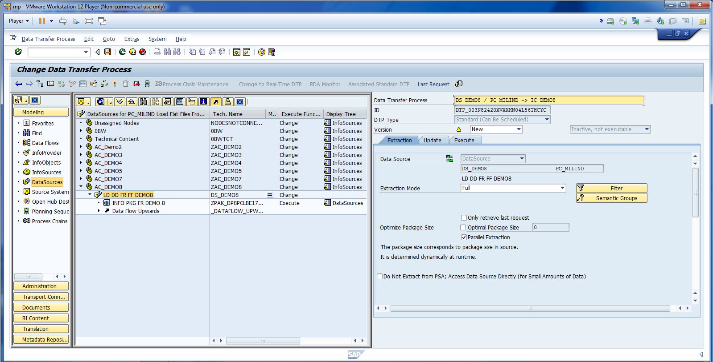
Update Extraction.

Slide 44
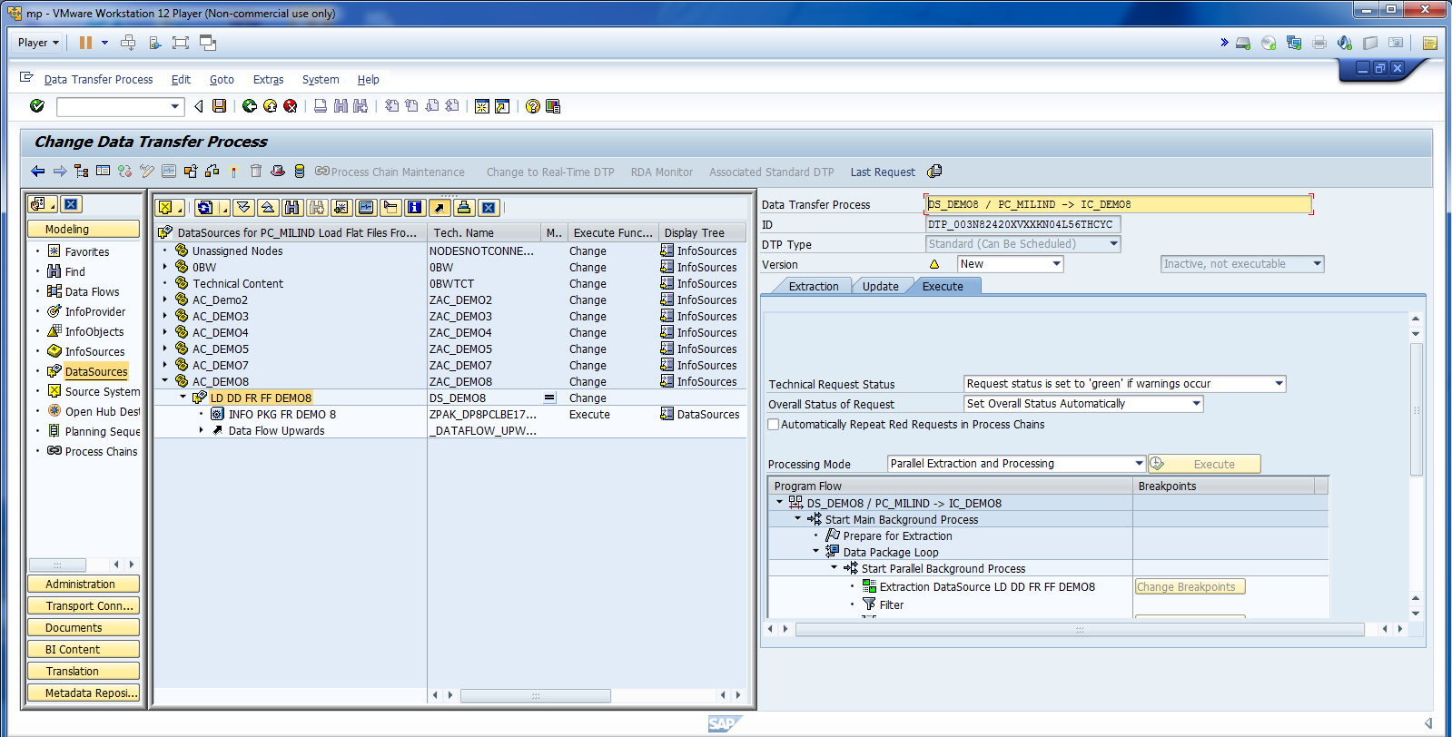
Activate DTP, But DON’T CLICK ON EXECUTE.

Slide 45
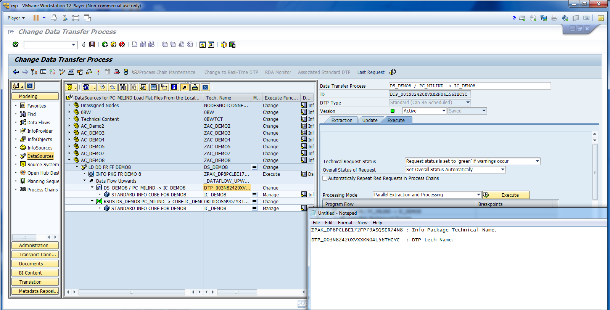
Copy DTP name.

Slide 46
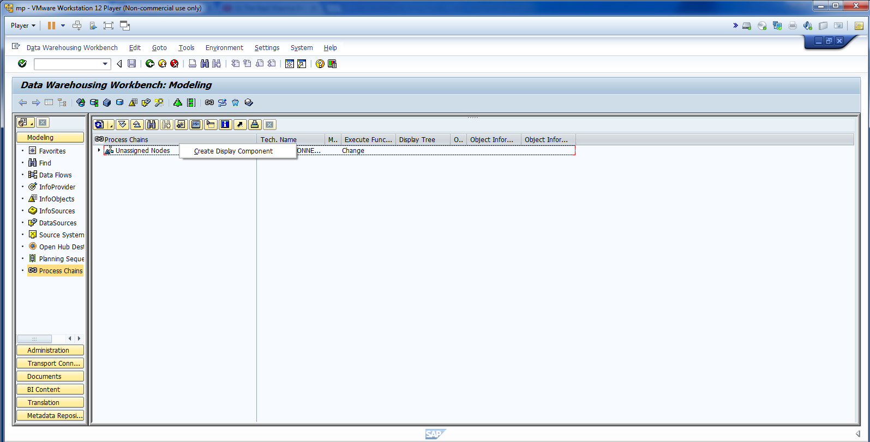
Go to Process Chain: T Code: /ORSPC

Slide 47
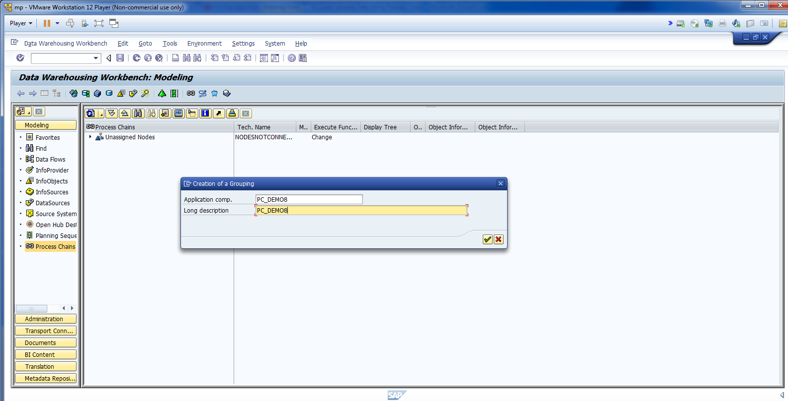
Create Display Component.

Slide 48
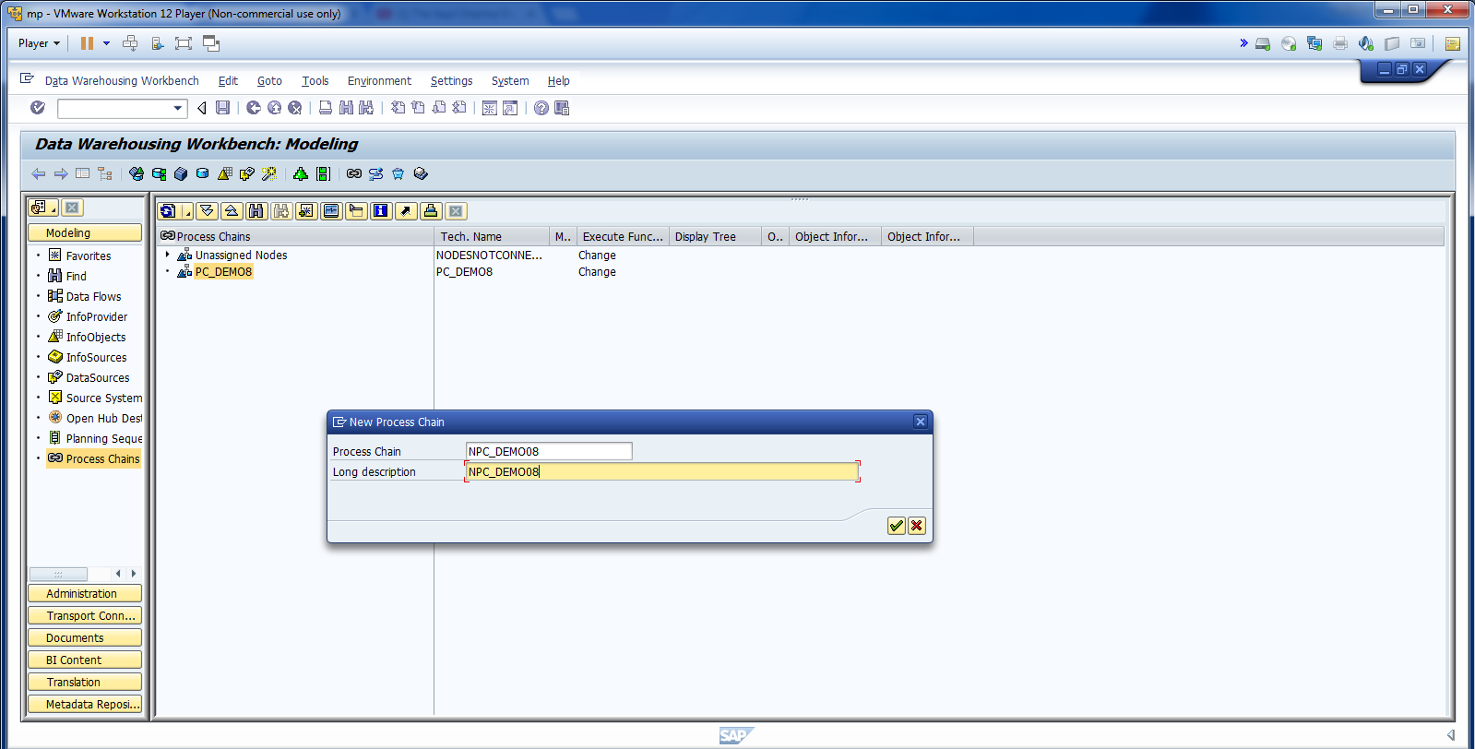
Cont.

Slide 49
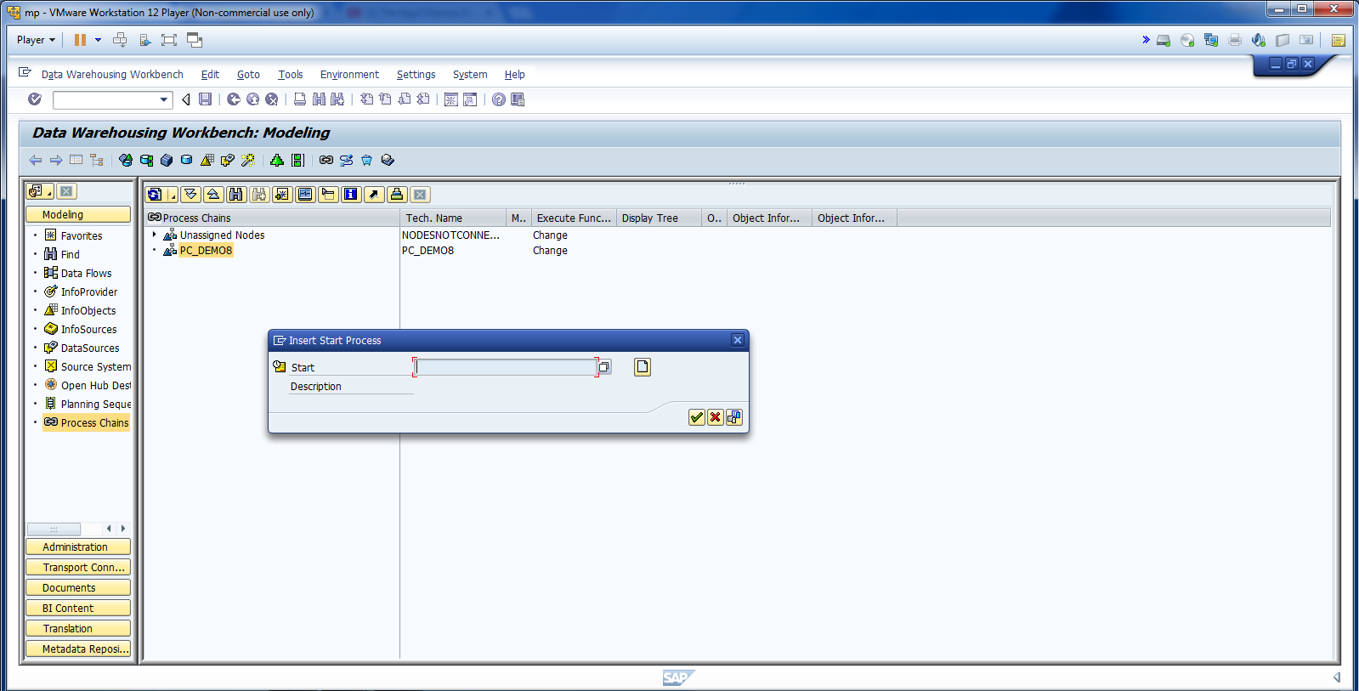
Create Starting Point for PC.

Slide 50
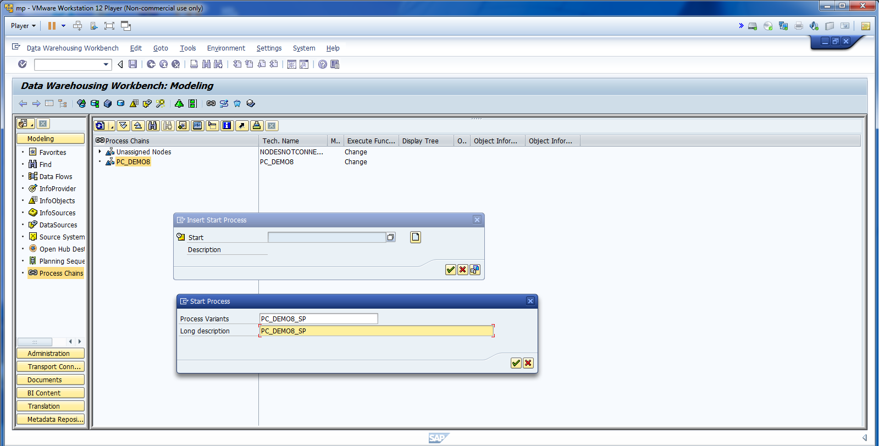
Cont.

Slide 51
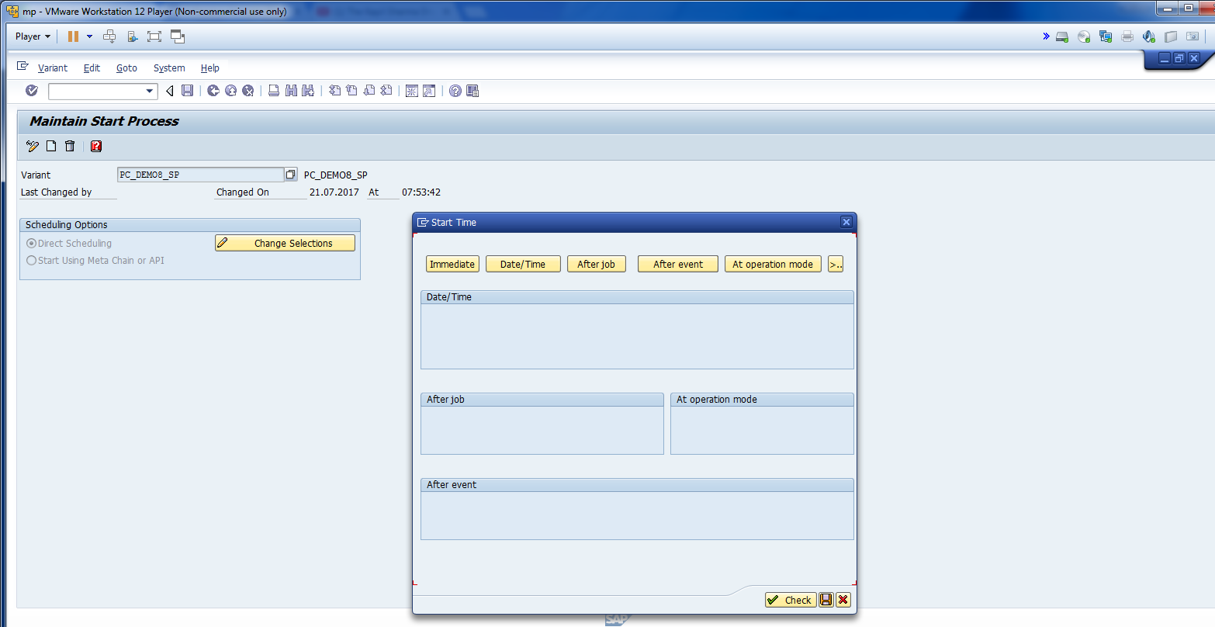
For Demo purpose, lets start immediately.

Slide 52
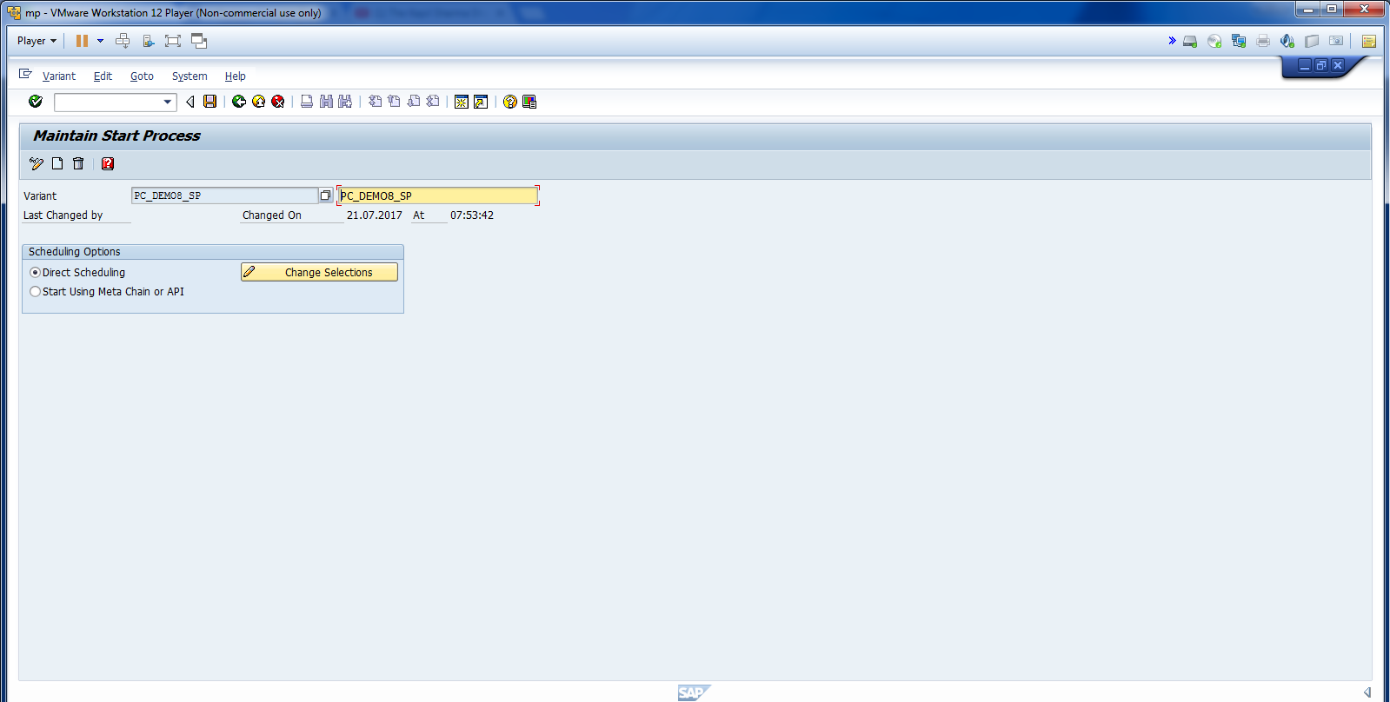
Save and go back.

Slide 53

Click on start process.

Slide 54

Enter Info Package name to transfer Data from FF.

Slide 55

Create Delete Index.

Slide 56

Cont.

Slide 57

Save It.

Slide 58

Go Back. Your Delete Index will be ready.

Slide 59

Change the view from Setting from Tree to Network View.

Slide 60

Activate the process.

Slide 61

Click On Schedule.

Slide 62

Cont.

Slide 63

Check Job Log.

Slide 64

Click on Process Monitor.

Slide 65

Cont.

Slide 66

Cont.

Slide 67

Data has been loaded through Process Chain.

Slide 68

Now, Check the data in Info Cube.

Slide 69

Select Administrative Target.

Slide 70

Data successfully loaded into InfoCube.

